Slide 1
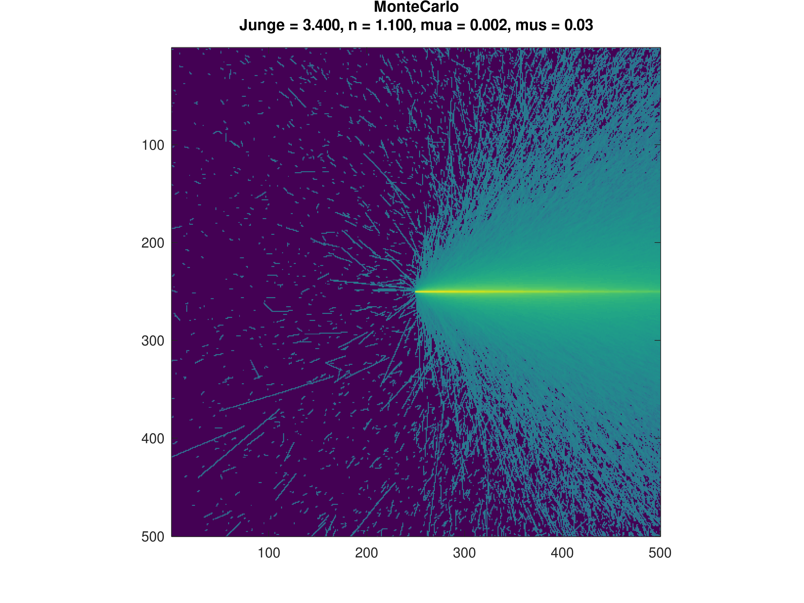
Turbidity Meter Simulation
Results Meeting

Slide 2
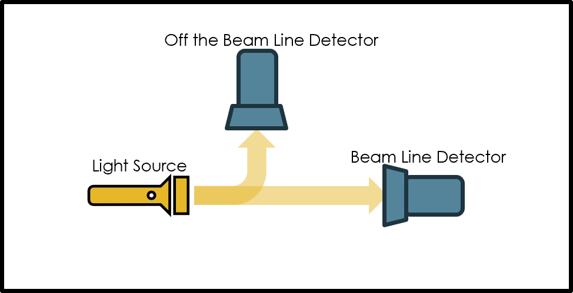
The Question
How to maximize sensitivity and irradiation of the off-beam detector?

Slide 3
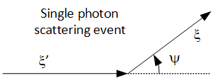
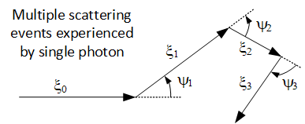
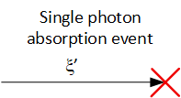
The Irradiation Problem
As individual photons propagate through water, they scatter and change direction by interacting with the particles in the water.
For photons traveling in +x direction to travel in the +z direction, several low probability scattering events are necessary.
The distribution of these events match the Fornier Forand Distribution
The frequency of these events is dictated by the scattering coefficient
Photons also interact with the medium and get absorbed

Slide 4
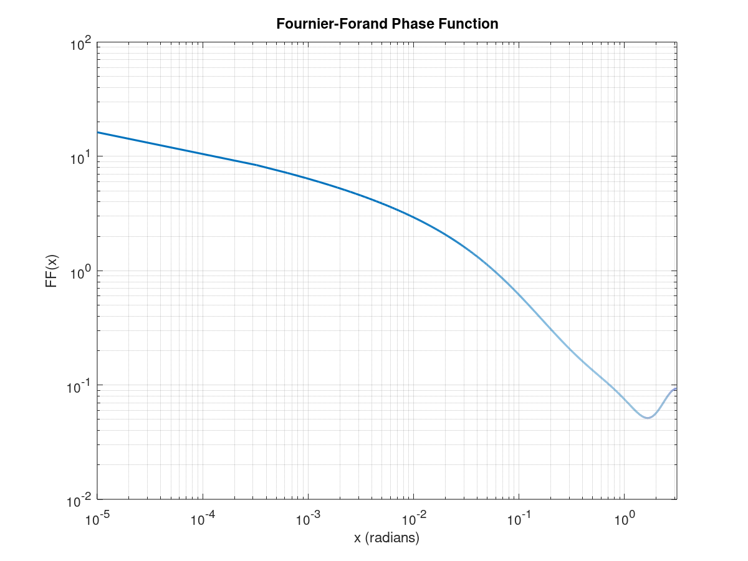
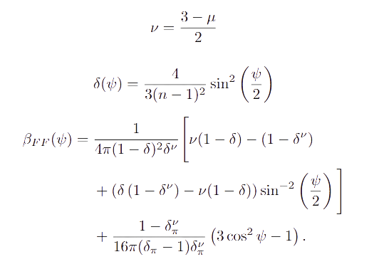

The Fornier Forand Distribution
The Fornier Forand Distribution is a function that is defined by 2 parameters namely the junge parameter and the index of refraction. It takes the scattering angle and returns the probability of scattering in that direction. For single scattering events. A monte carlor simulation is needed to compute the regime for which many events happen.

Slide 5
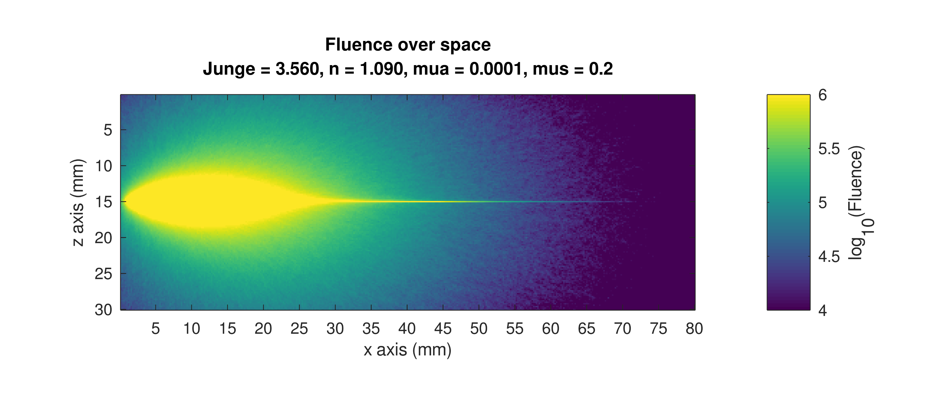
How to Position The Detector
Given that the offset from the beam in the z direction is the main engineering limitation, what is the best position on the x axis?
Needs enough distance to scatter sufficiently, needs to be measured before too much absorption
Illustrative fluence map with an unrealistically high scattering coefficient (μs = 0.2 mm−1, μa = 0.0001 mm−1.

Slide 6
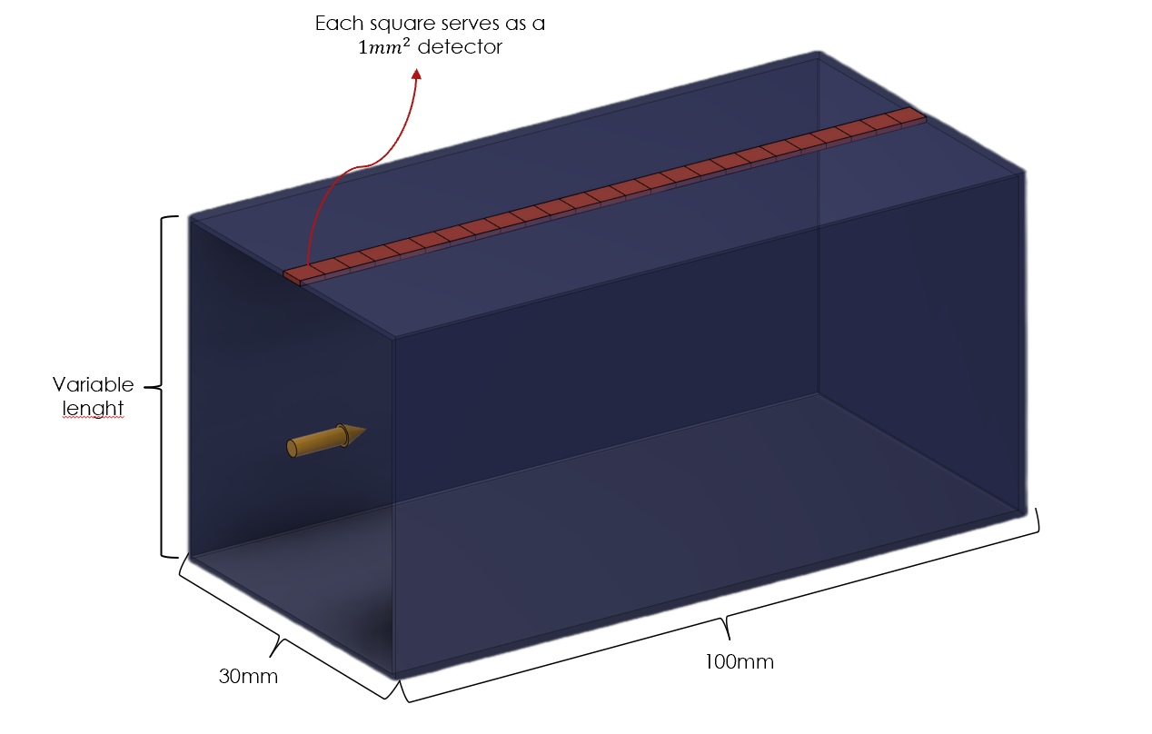
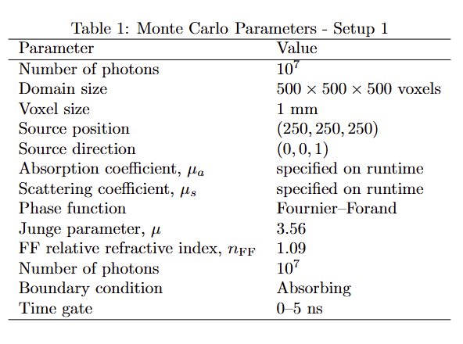
Experimental Setup

Slide 7
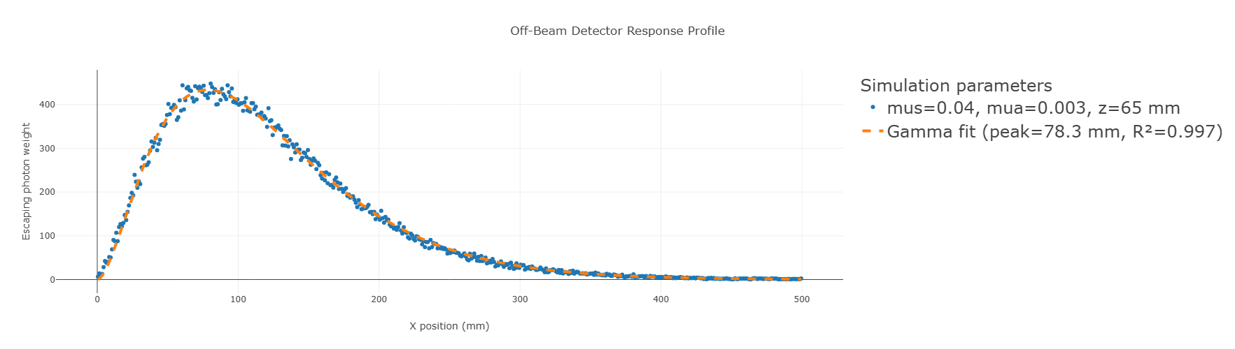
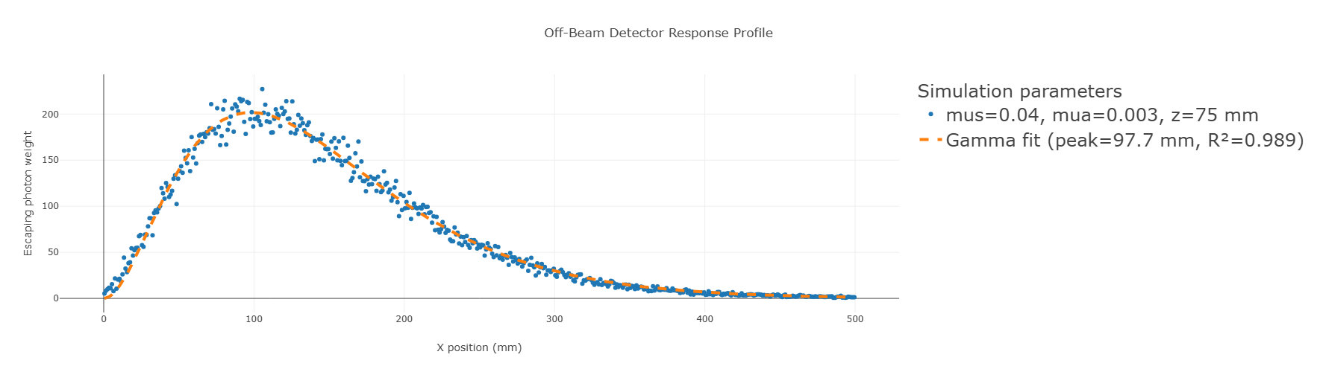
Results z=65,75
Peak
Visible change in the peak position
Peak

Slide 8
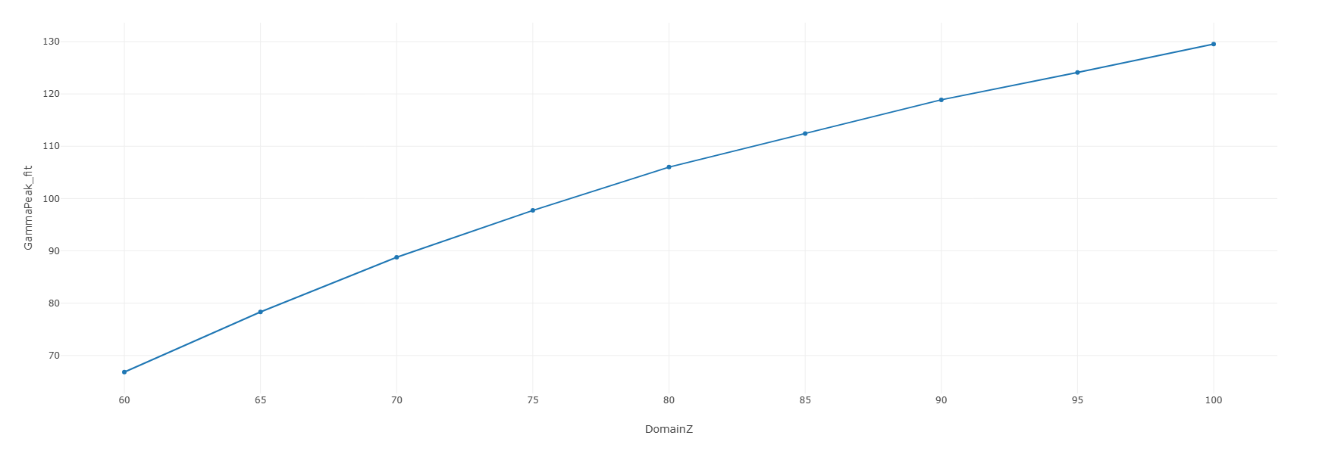
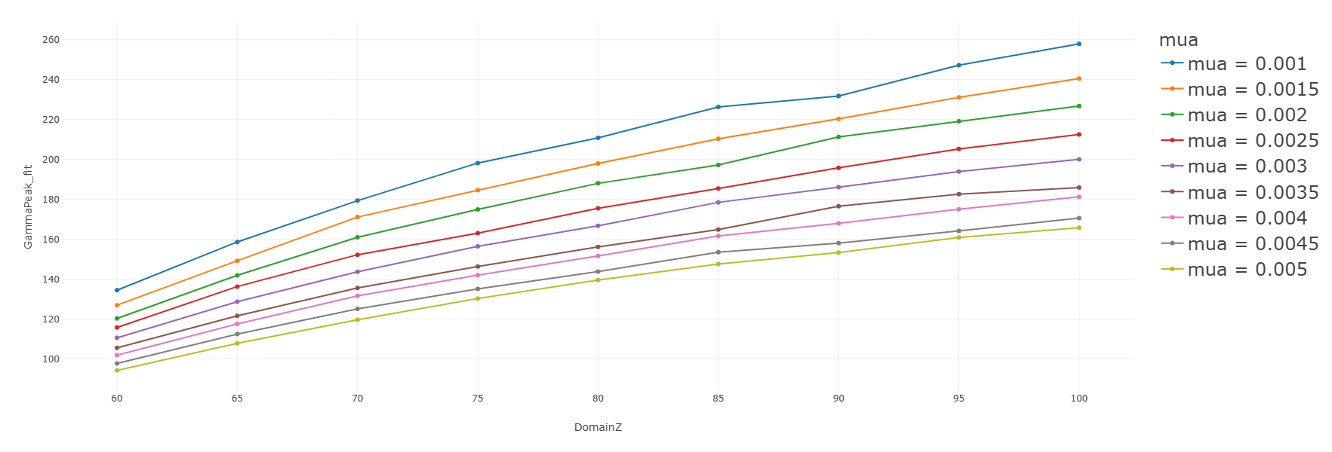
Results for other Z
The trend is a sublinear increase in the peak position’s distance to the source in the x direction. It is important to mention that this plot shows where the peak is, not how tall the peak is.

Slide 9
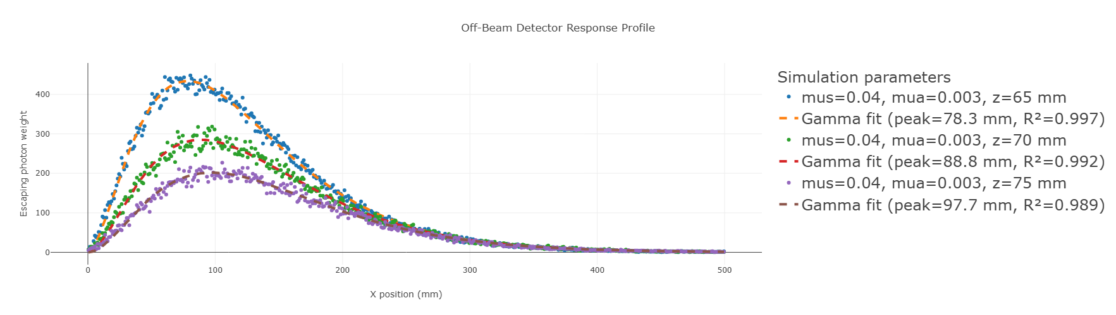
Comparison of different heights
We can see that as the z increases, meaning the off the beam detector is farther away from the beam axis, the peak’s amplitude reduces.

Slide 10
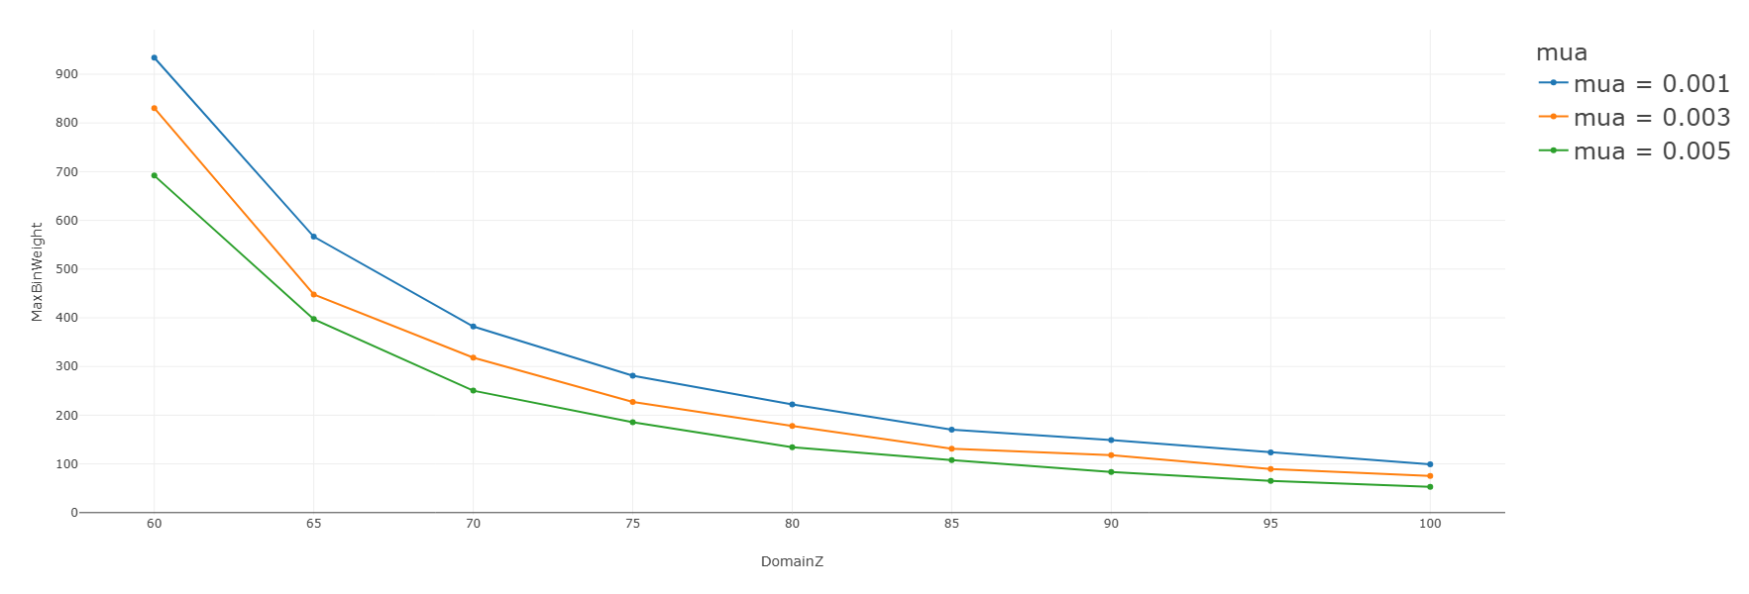
How tall are the peaks
The height of the peaks show decline as the z coordinate is increased as expected. The magnitude of absorption also affects this.

Slide 11
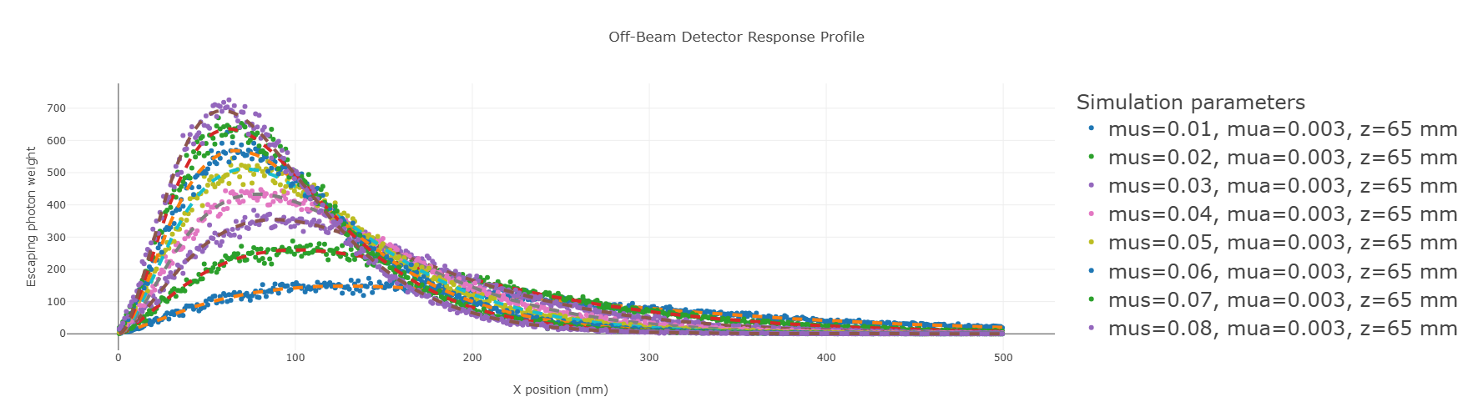
The Sensitivity Problem
It is important that the detective is positioned such that it is sensitive to reasonable change in turbidity.
Turbidity is proportional to the coefficient of scattering
For highly turbid waters, the coefficient of scattering is assumed to be 0.02 ≥ μs ≥ 0.1
The figure below compares the detector distribution graphs of a system with μa = 0.003,B_FF = 0.0144, and z = 65mm for a range of different μs.

Slide 12
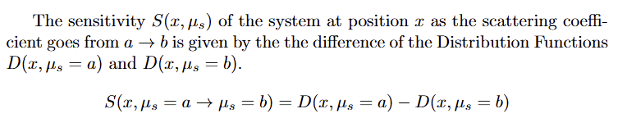
Defining Sensitivity

Slide 13
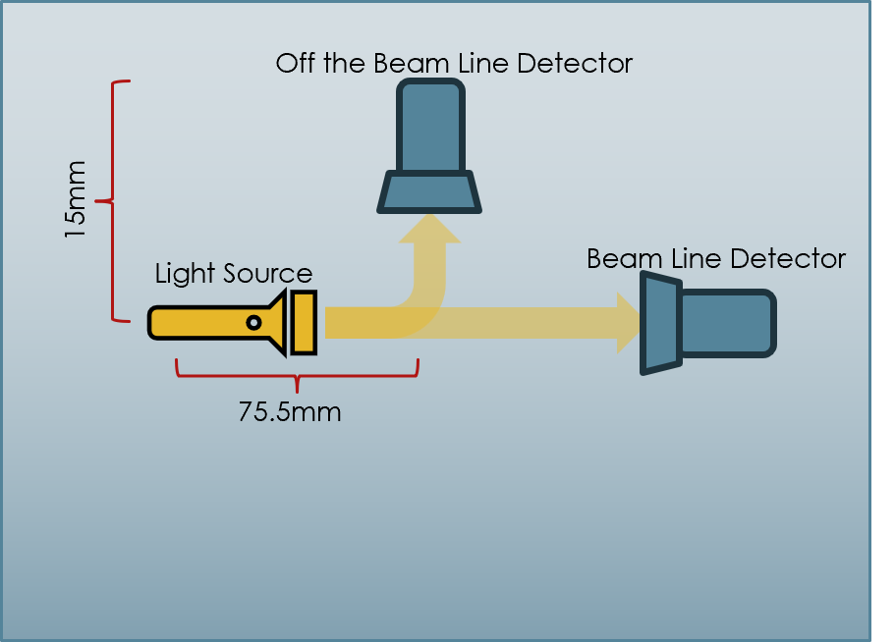
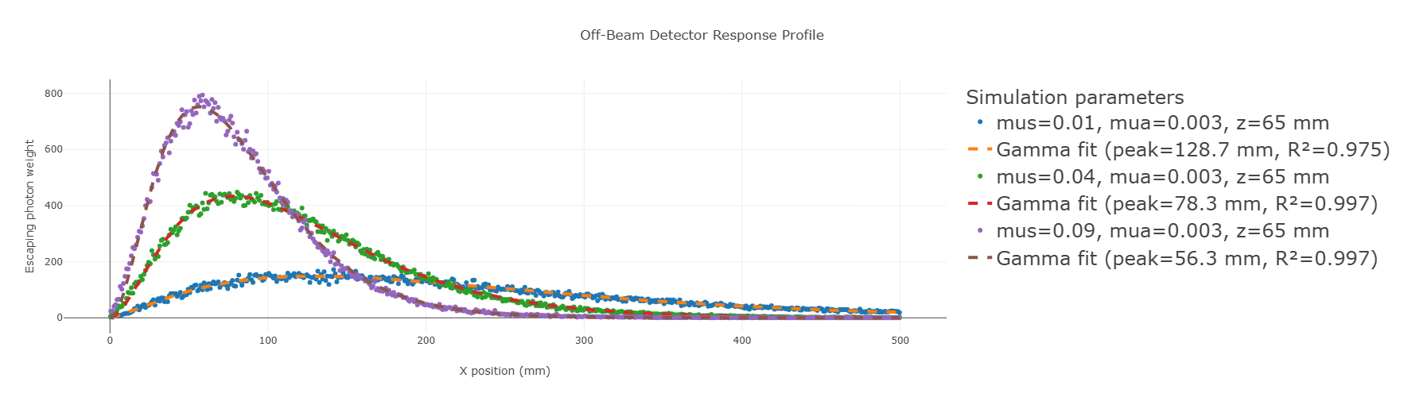
Example Sensitivity Measurement
Let μ_a = 0.003,z = 65mm, source z position = 50mm,B_FF = 0.0144.
Let x position of the detector be x=78.3 such that radiance is max for μ_s=0.04

Slide 14
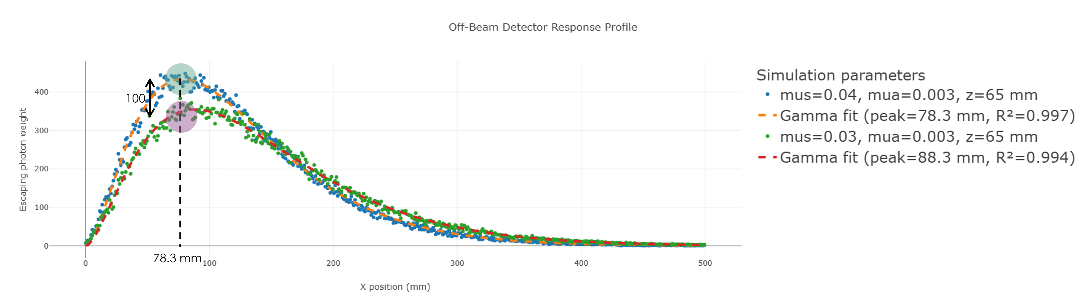
Example Sensitivity measurement
In order to find the sensitivity of the detector in this setup moving from μs = 0.04 → 0.03 we preform the following operation.

Slide 15
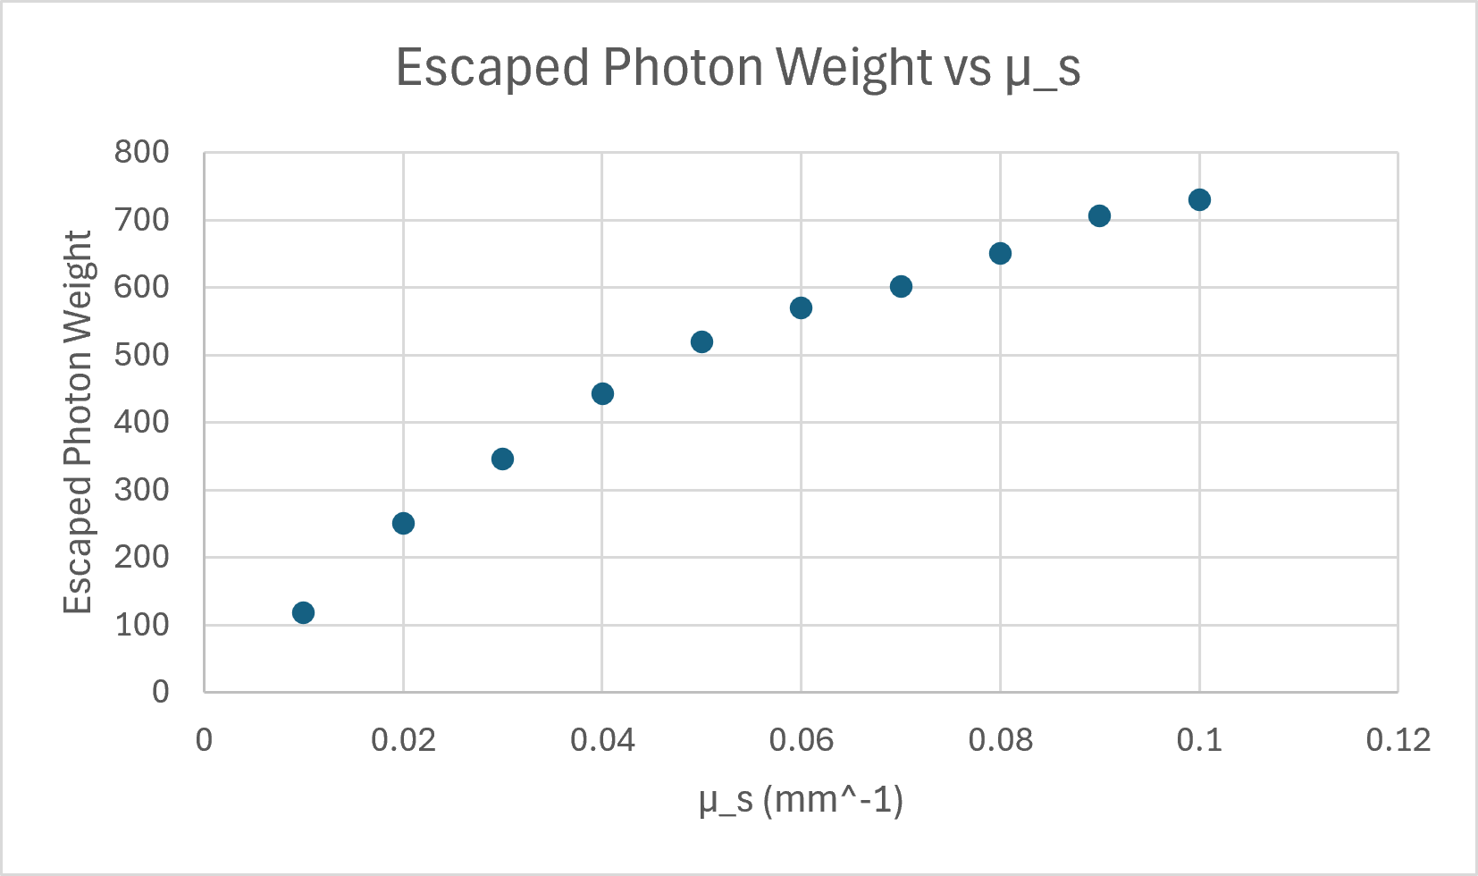
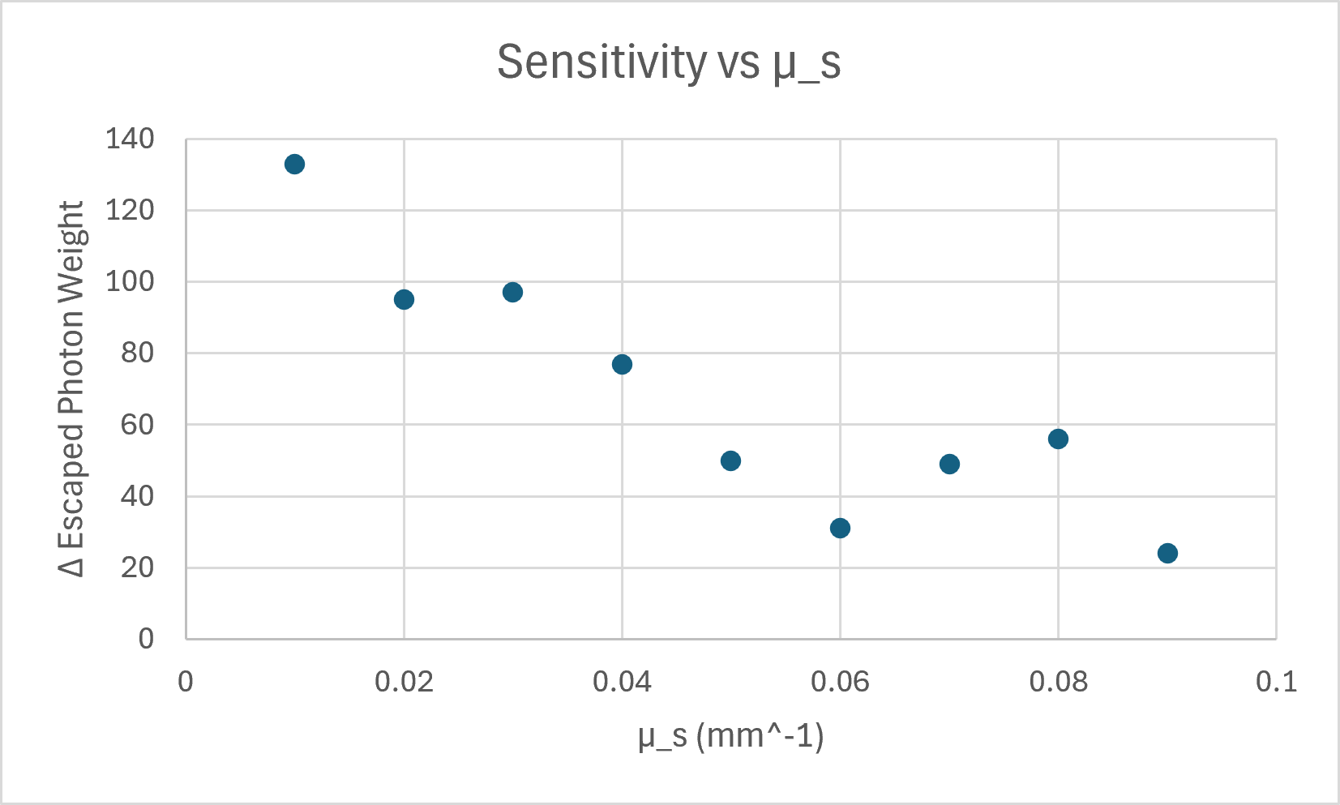
Example Sensitivity Measurement
Measuring the escaped photon weight at along the same x value for other μs values and plotting it we reveal figure the figure below. While photon weight seems to show a sublinear trend, the sensitivity trend seems to linear with some blips potentially due to noise.

Slide 16
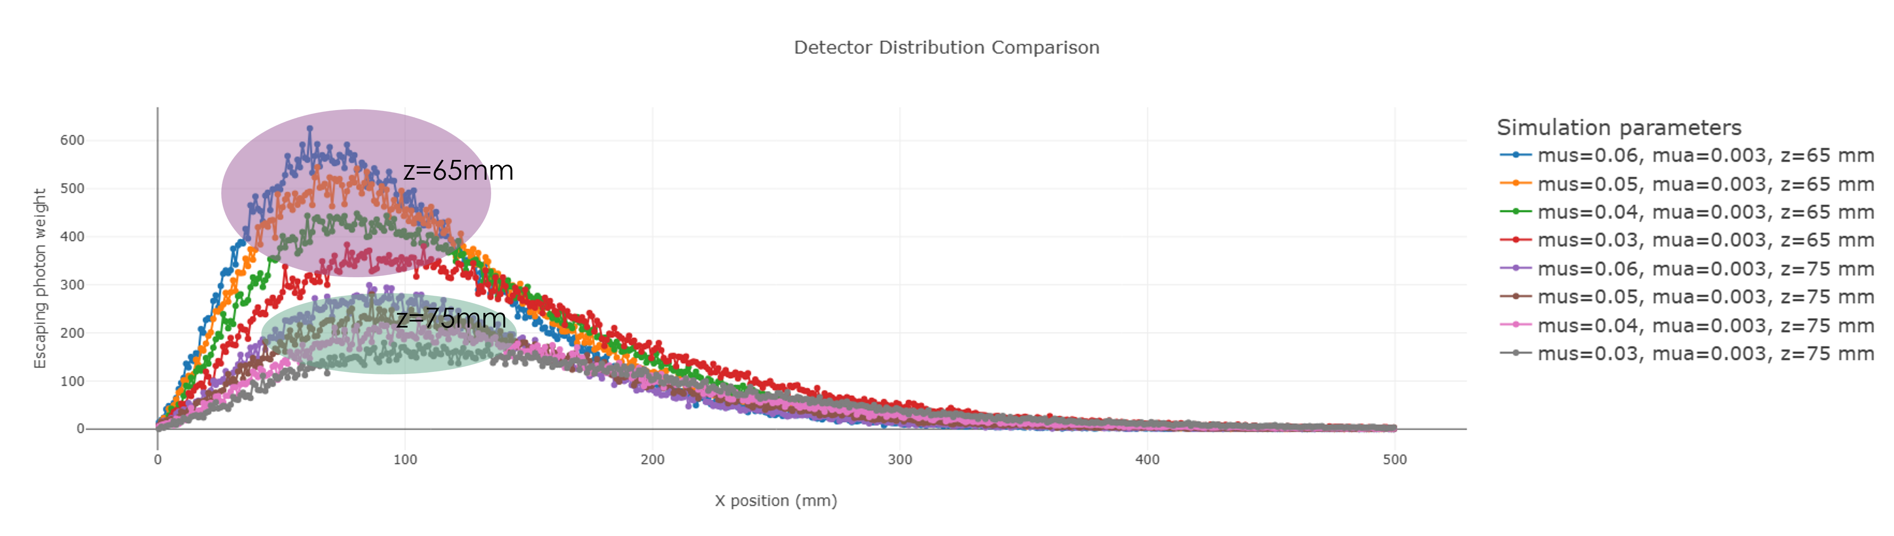
Moving beyond the example case: Relationship between detector height, z, and detector sensitivity
For smaller z we see that there is more distance between the distributions at a given x around the peaks. As such, we conclude that smaller z allows for higher sensitivity. The next slide also considers the relative distance of the graphs to their absolute amplitude.

Slide 17
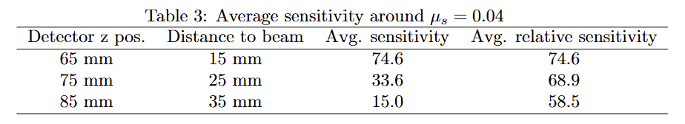
Moving beyond the example case: Relationship between detector height, z, and detector sensitivity
After a lot of math found in the report we get the result that smaller detector distance from the source sureley yields higher sensitivity even when considering the relative sensitivity.

Slide 18
Conclusion
For a classical turbidity meter device, proximity of the positioning of the off the beam detector increases the received radiance as expected. The proximity also increases sensitivity to change in μs or turbidity. The following graph tells you the best x position for a given z, and IOPs. Different IOPs and z values may be explored in the following link with an interactive plotter: https://kaanvolkan05.github.io/TurbidWater.

Slide 19
Beyond this slide are previous presentation slides and various figures used

Slide 20
How to position the detector
Off the beam line Detector
Beam Line Detector
Light Source

Slide 21
Simulation Innerworkings
Photon launches with a packet weight 1 and direction v
Based on an exponential distribution based on the scattering coefficient (μ_{s}) of the current voxel, it decides how many voxels to travel in v direction.
Steps 1 voxel in v direction and looses packet weight based on the absorption coefficient (μ_{a})
The packet weight is added to its current voxel’s raw probability,
The previous 2 steps are repeated until the package reaches the next scattering voxel decided in the second step
Calculate a new scattering direction vector: the azimuth and zenith scattering angles are computed, respectively, by a random number uniformly distributed in [0,2pi] and a random number between [0,pi) following an assigned phase function.
Repeat from step 2 until the max time is reached or the photon exits the domain
Repeat all steps for next photon

Slide 22
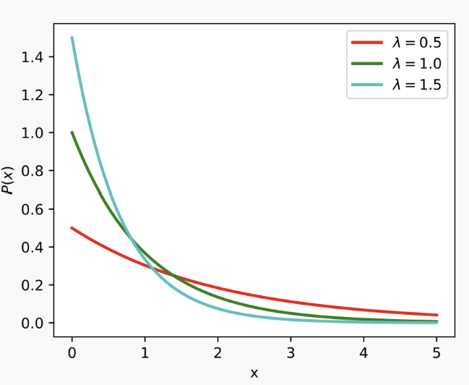
Photon Launches with weight 1 in v dir
Based on μ_{s}, photon travels n voxels
New scatter direction is determined
Previous steps are repeated until the boundary is left or no more time is left
n
Weight is reduced based on μ_{a}

Slide 23

Monte Carlo Simulation Result

Slide 24
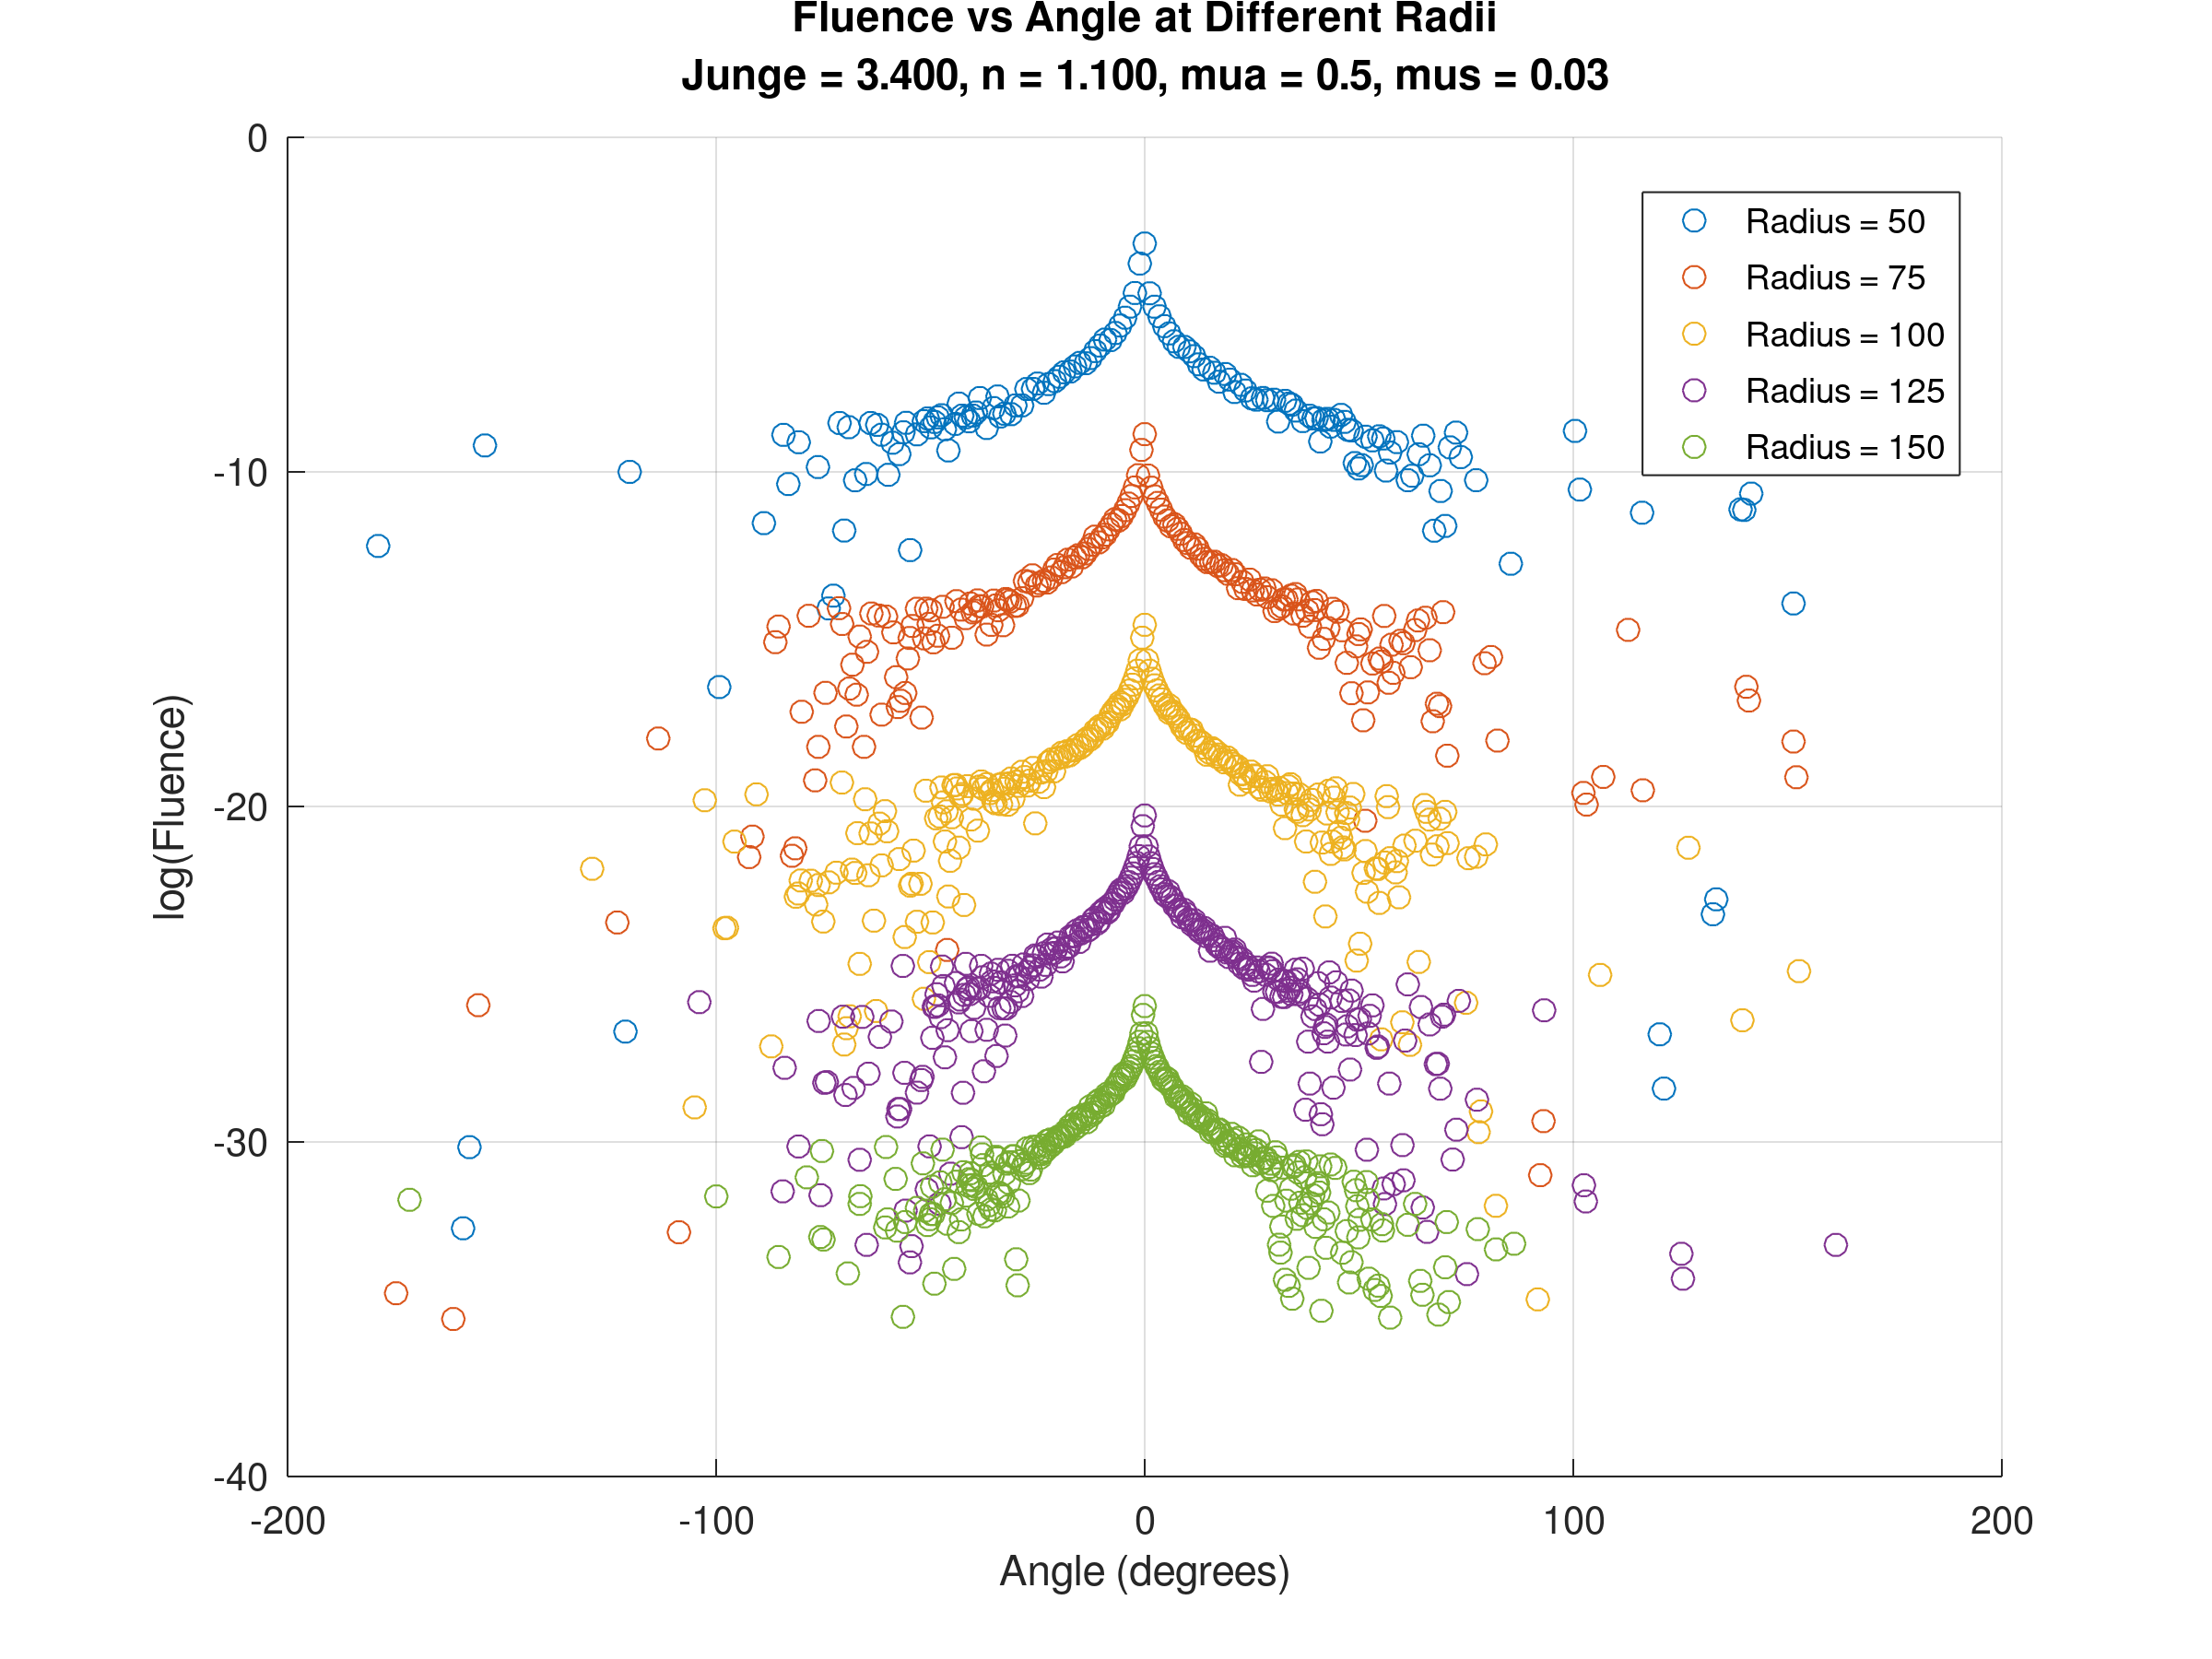
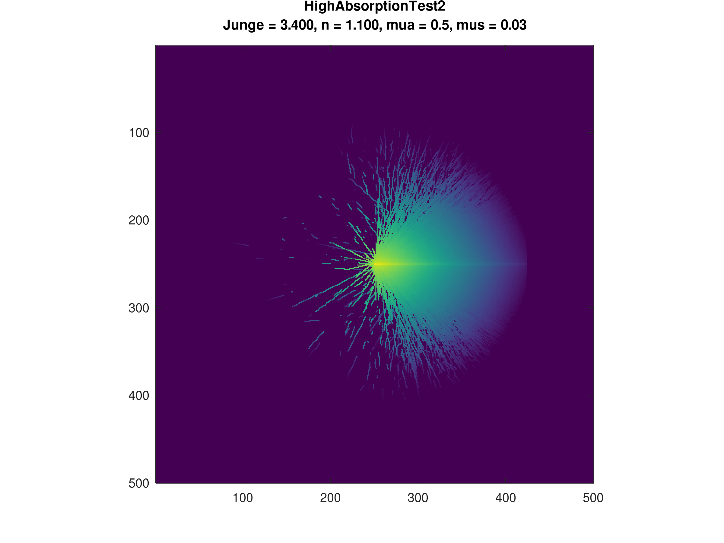

Slide 25
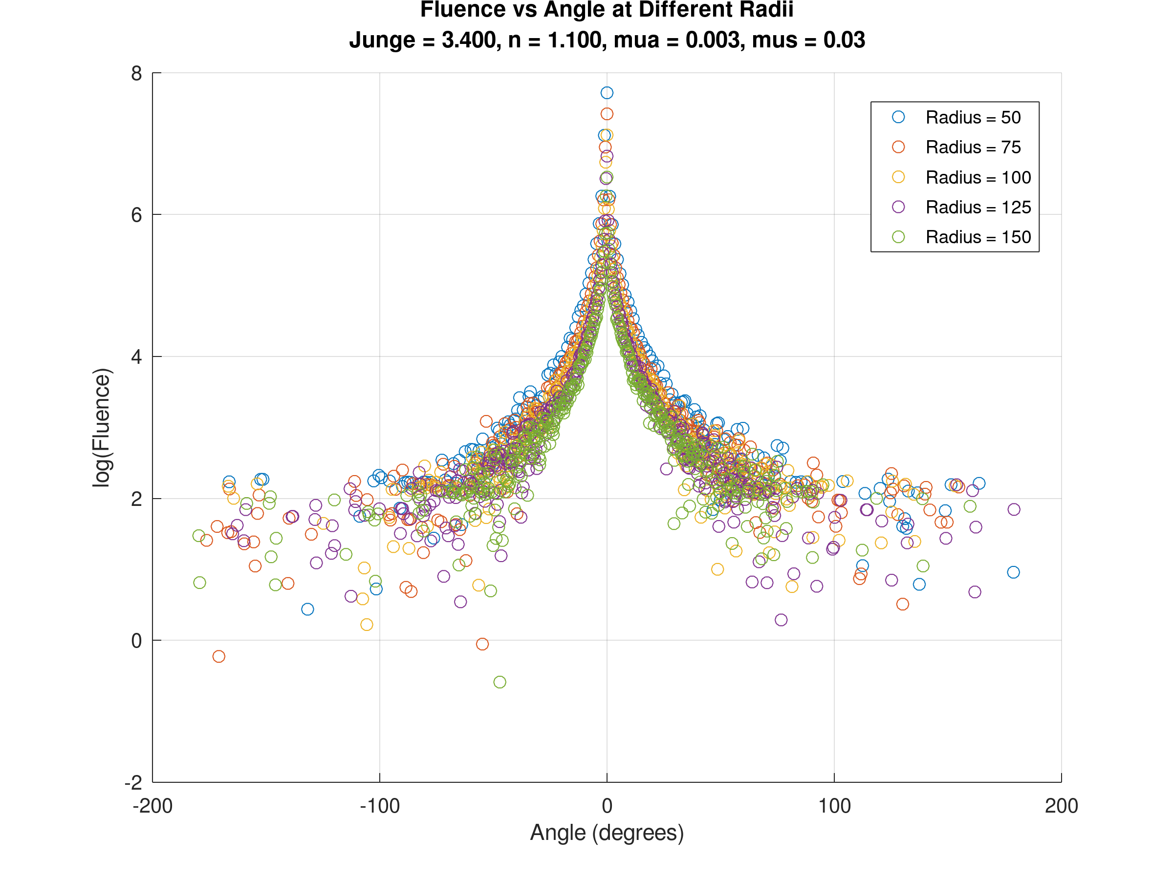
Angle test
For smaller radius the difference between the peak and bottom plateu become smaller from 4 times to 3 times the difference.
The issue is that these voxels have no min acceptance angle, so this is not an accurate representation of what the detector would see.

Slide 26
A better way
Imagine the image below is the x-y slice where the source is. The idea is to measure the light exiting the top boundary. Represent the intensity at the boundary along the y direction in a bar graph. Hence we know the best position to place the detector. The same can be done at the front face.
X-dir
Y-dir
50mm

Slide 27
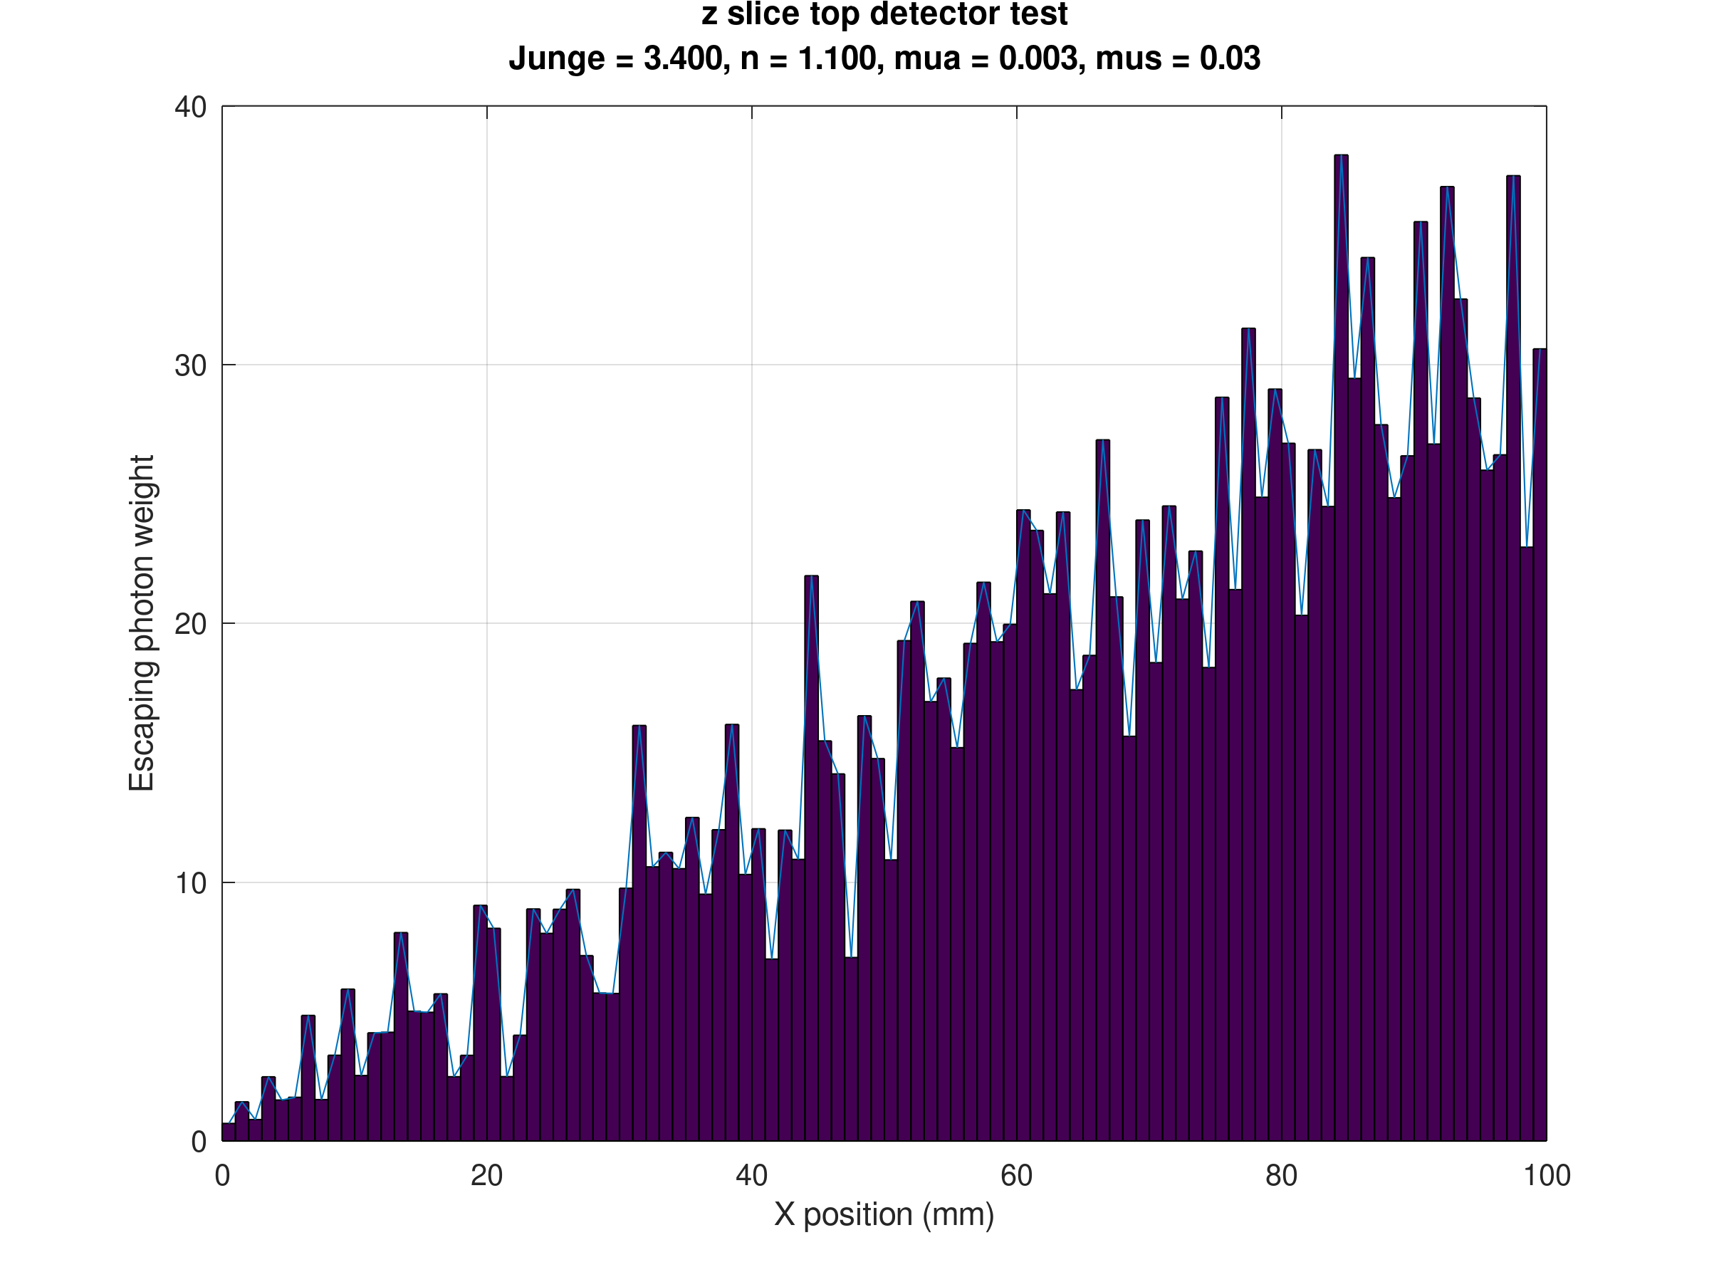
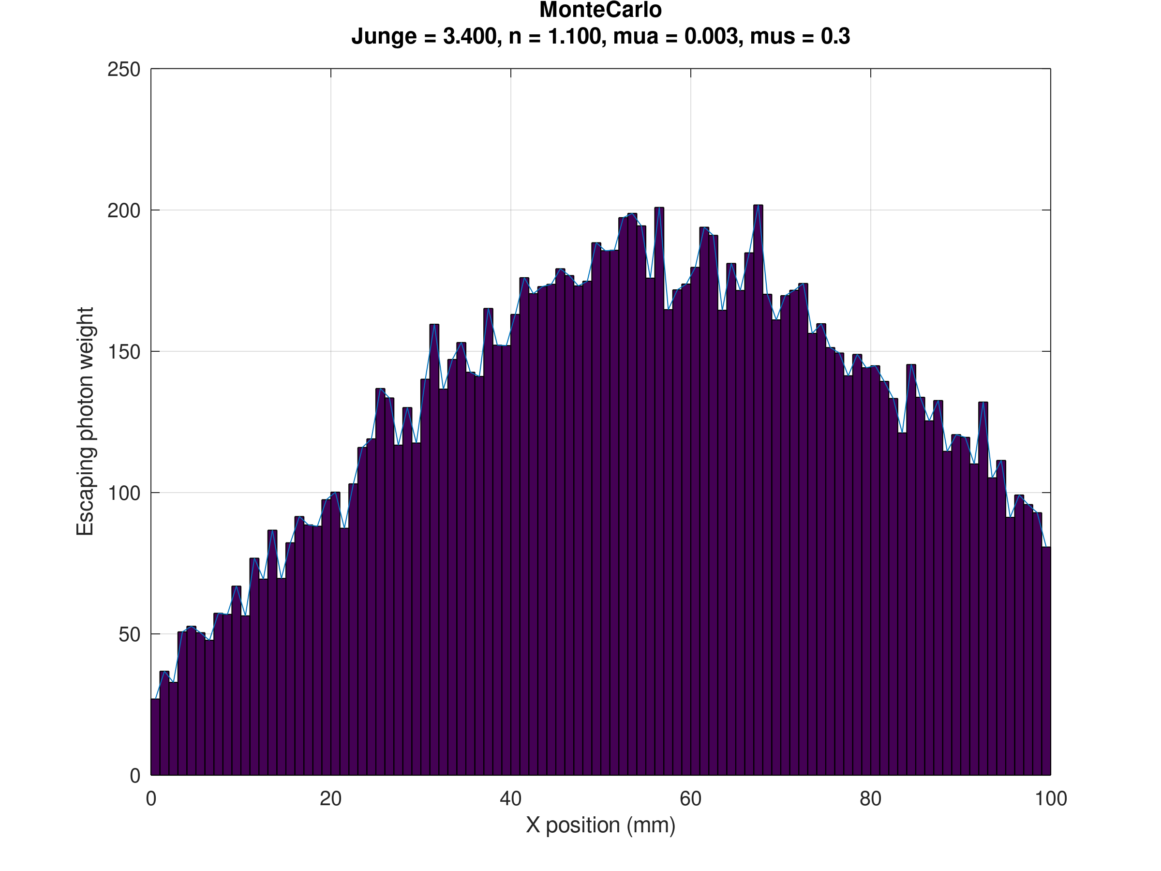
Results for the off beam detector at 50 mm

Slide 28
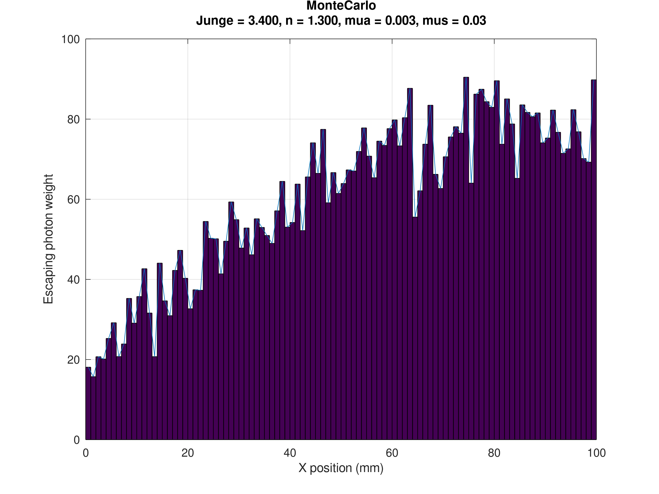
Results for the off beam detector at 50 mm continued

Slide 29
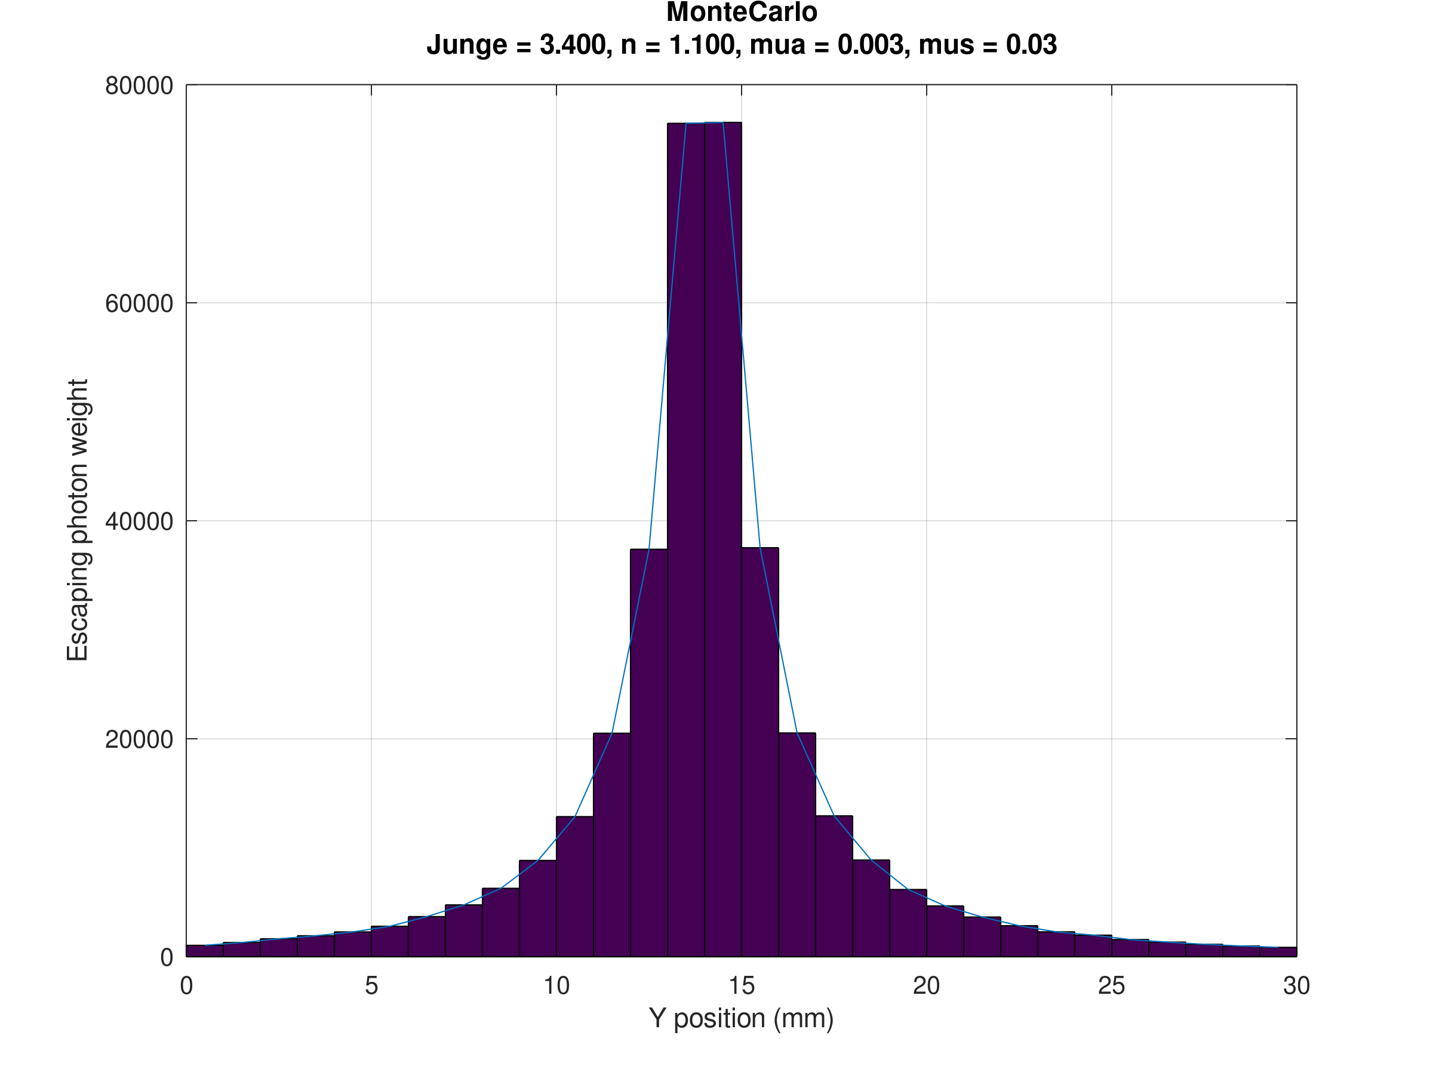
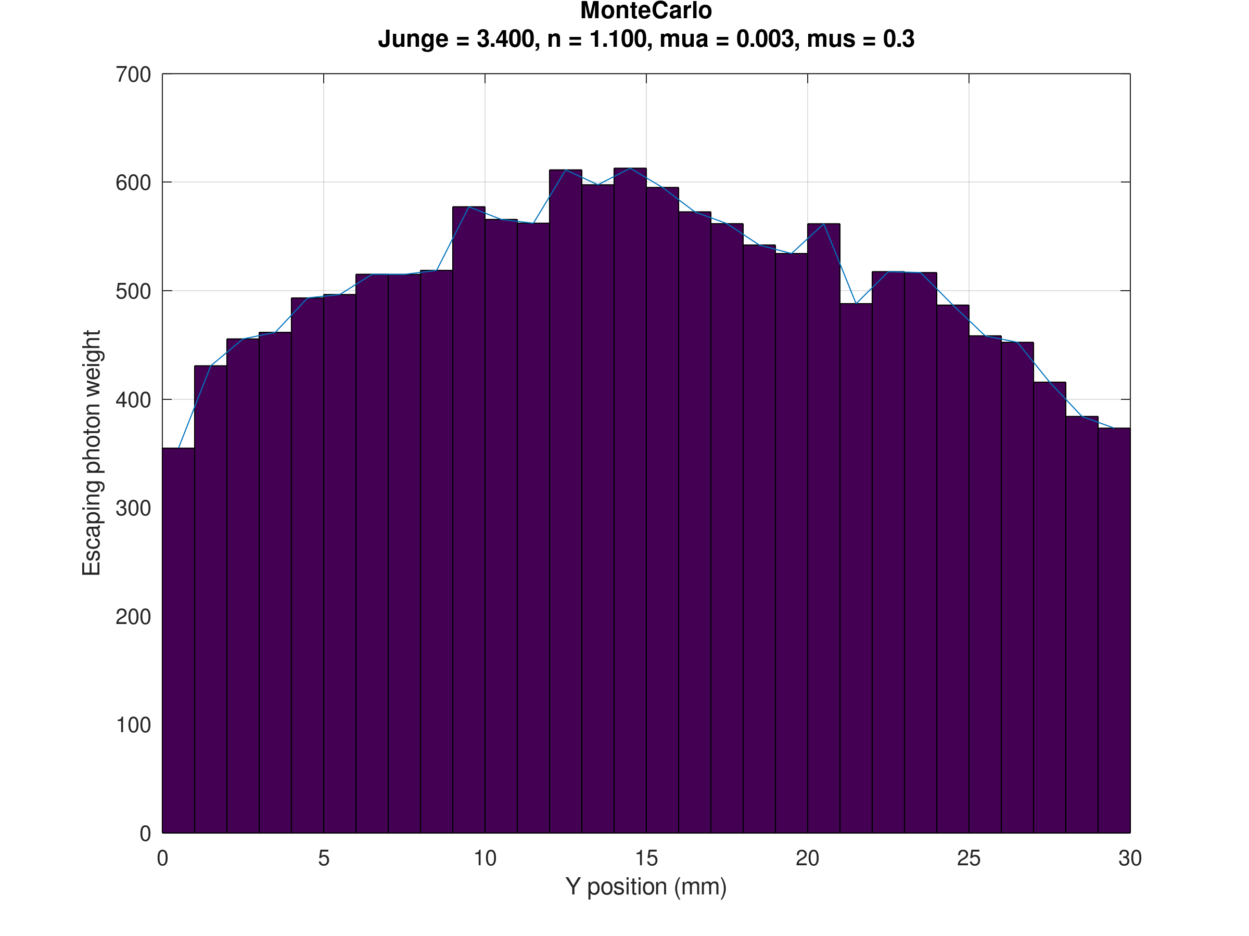
Results on the face perpendicular to the beamline at 100mm

Slide 30
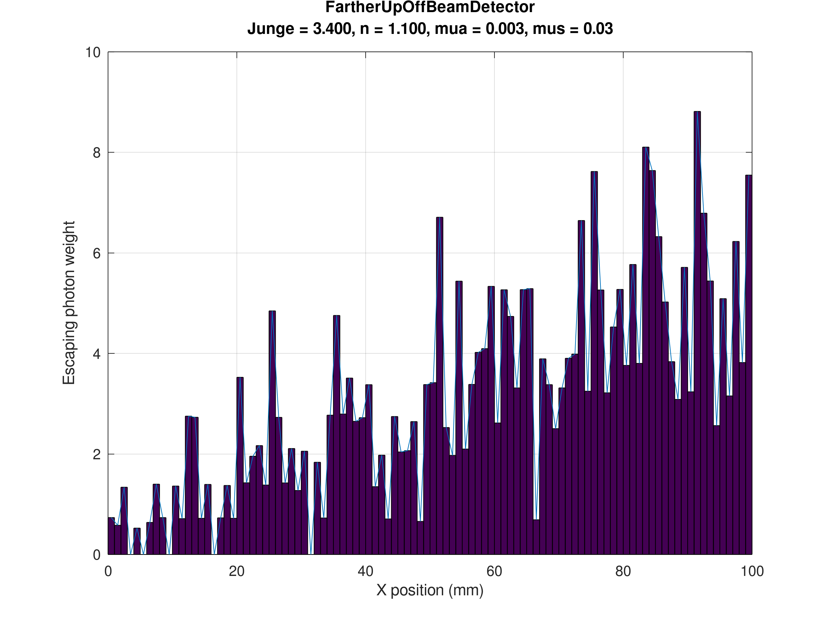
What if we go higher off the beam?
AT 100mm off beam
AT 50mm off beam

Slide 31
Sanity Checks
Under 0 scattering:
  Peak at zero degrees
  Absorption dependance must recover the beer lambert law
Under conditions where 1 scattering event per photon on average occurs:
  We must recover the Fornier Forand distribution
  HG and FF must be close
Under reasonable scattering:
  Increasing photon number must reduce std of solutions
  HG and FF must divarge
Under very large scattering:
  Source must look isotropic at a distance with no forward bias
  HG and FF must converge

Slide 32
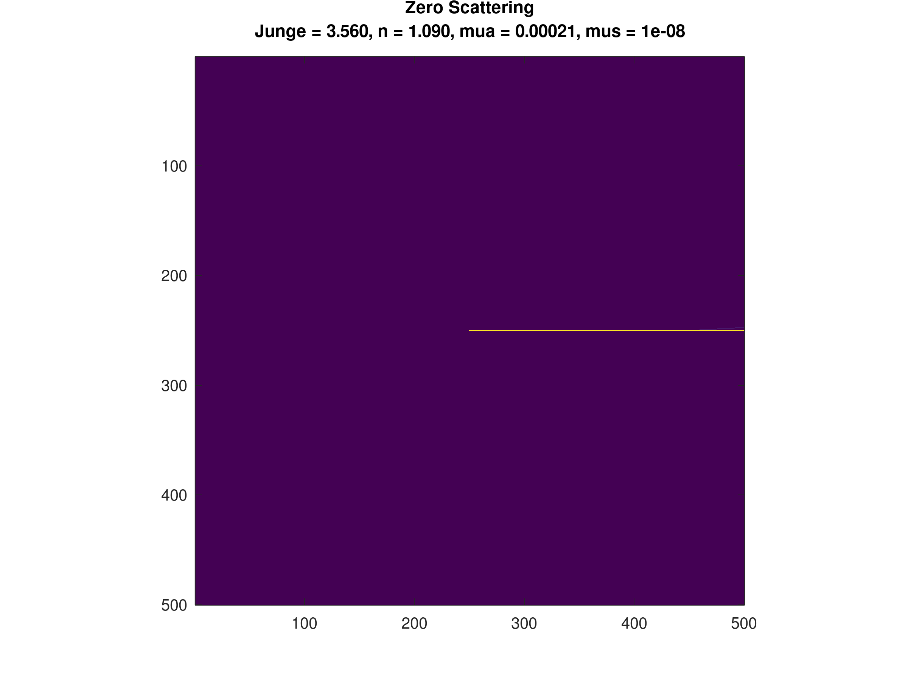
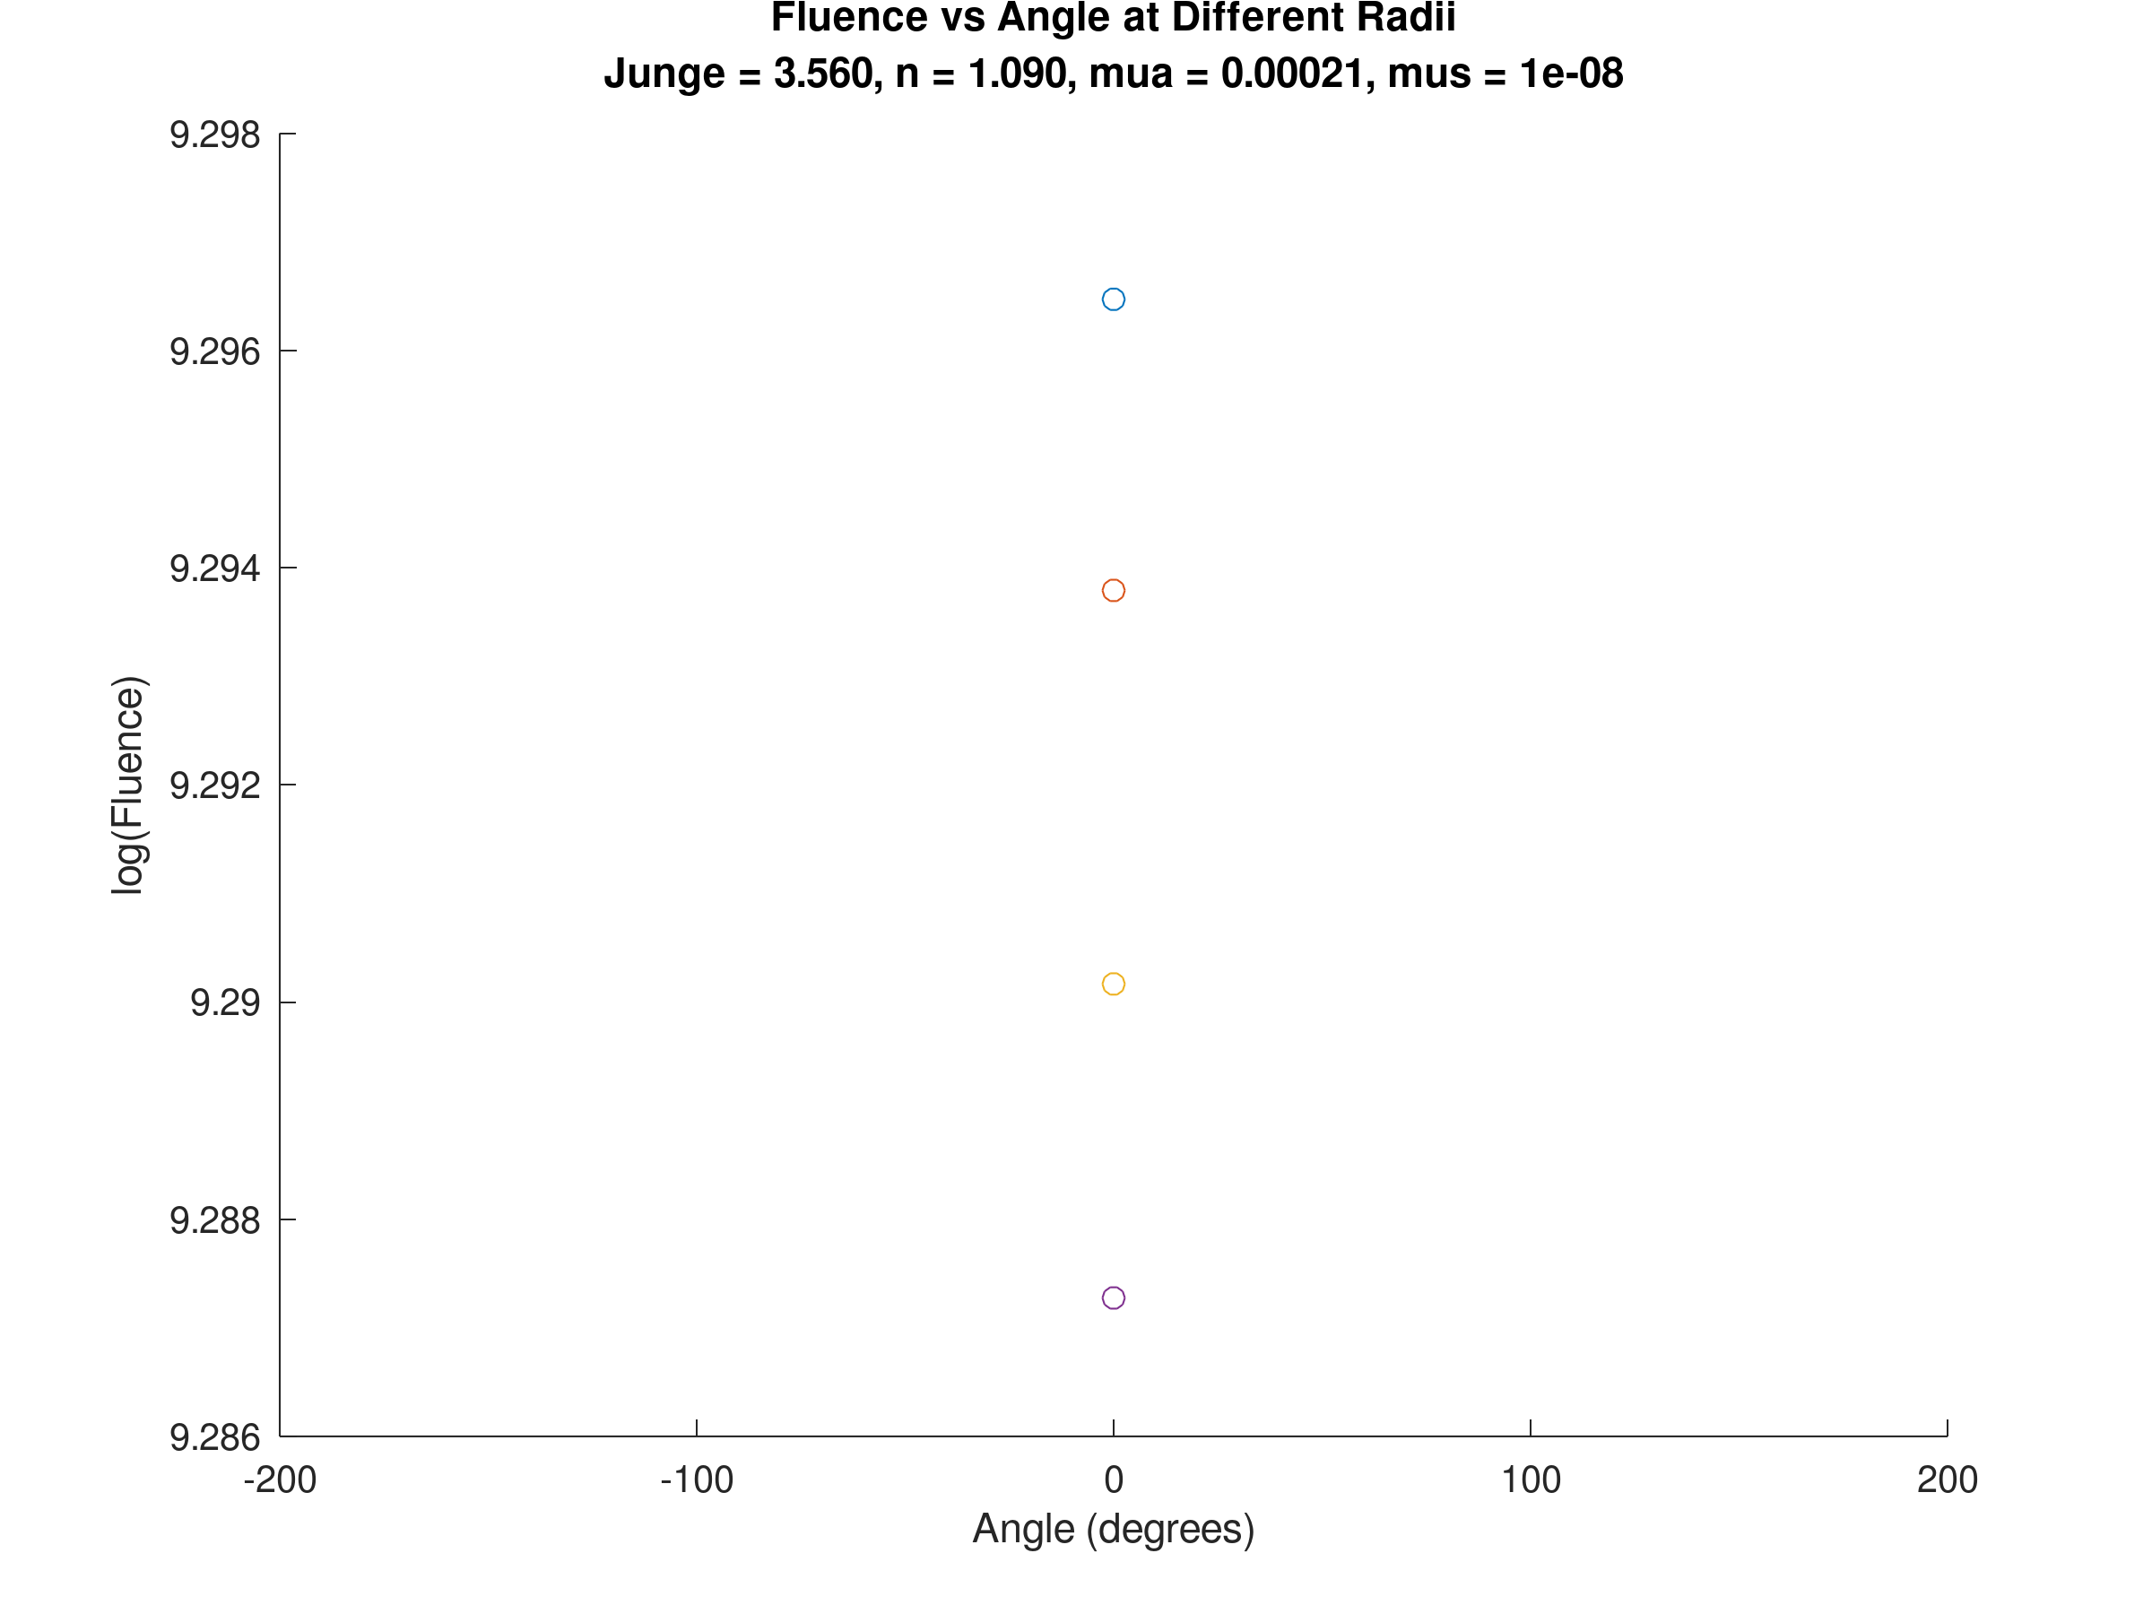
Zero Scattering Check
X-Y Slice of Monte Carlo Sim
Fluence measured at angles

Slide 33
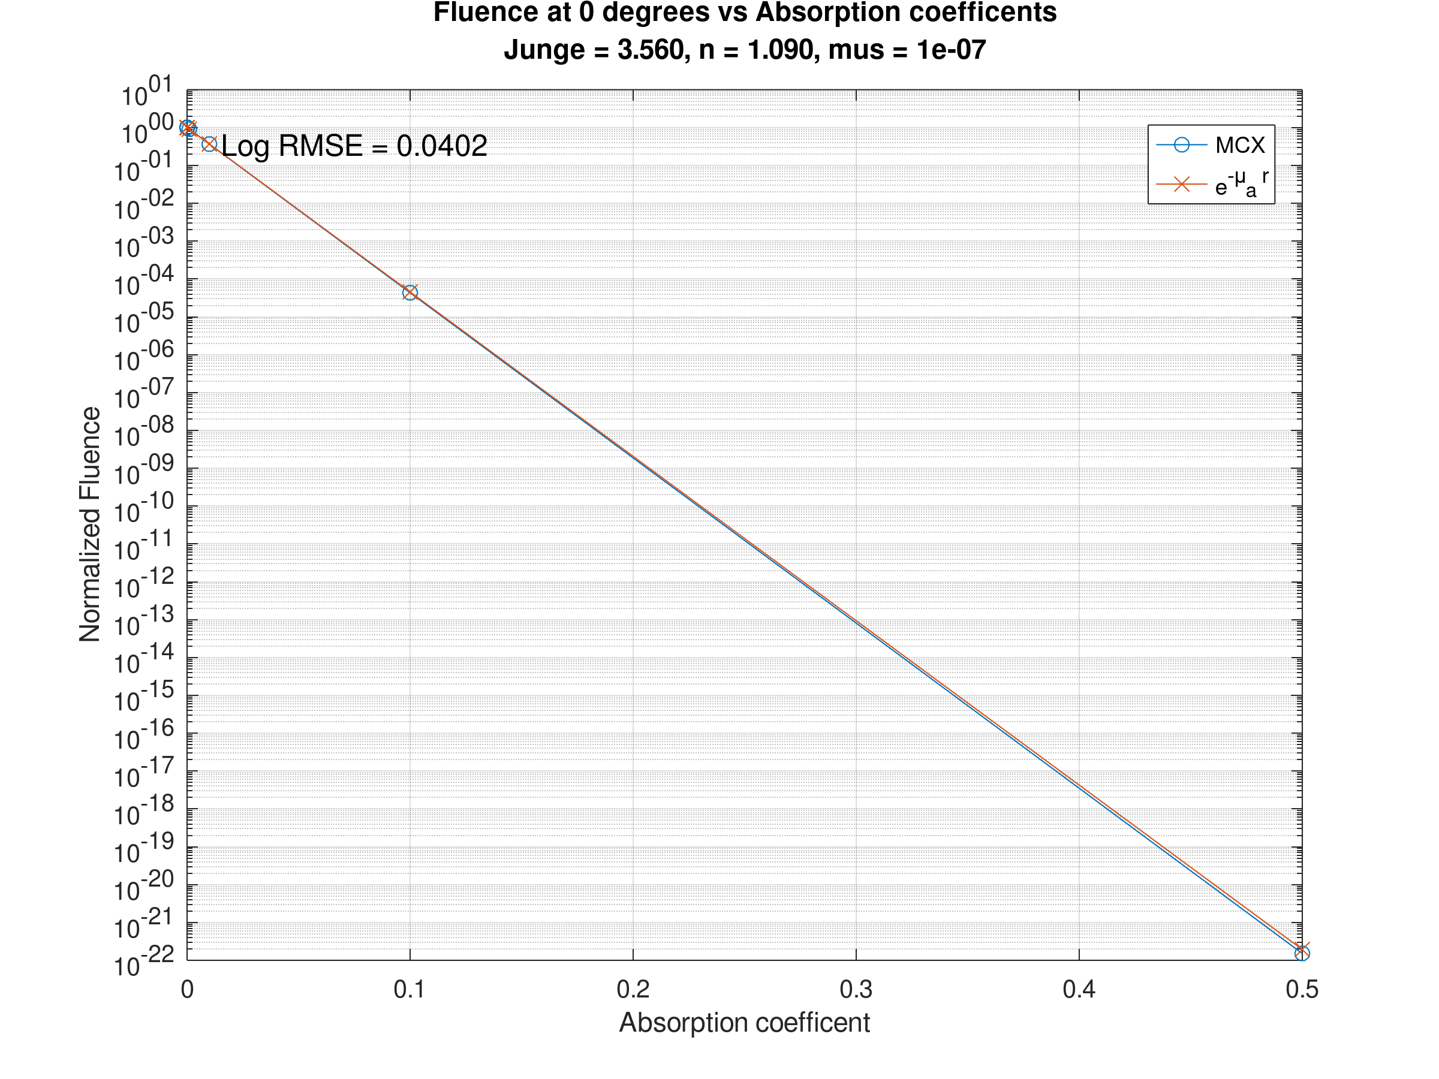
Absorption/Beer-Lambert Crosscheck
Absorption Coeff | Normalized Fluence | Beer-Lambert
1e-7 | 1.000 | 1.000
1e-5 | 1.007 | 0.999
1e-4 | 0.990 | 0.990
1e-3 | 0.904 | 0.904
1e-2 | 0.366 | 0.367
0.1 | 4.32e-5 | 4.54e-5
0.5 | ~0 | ~0

Slide 34
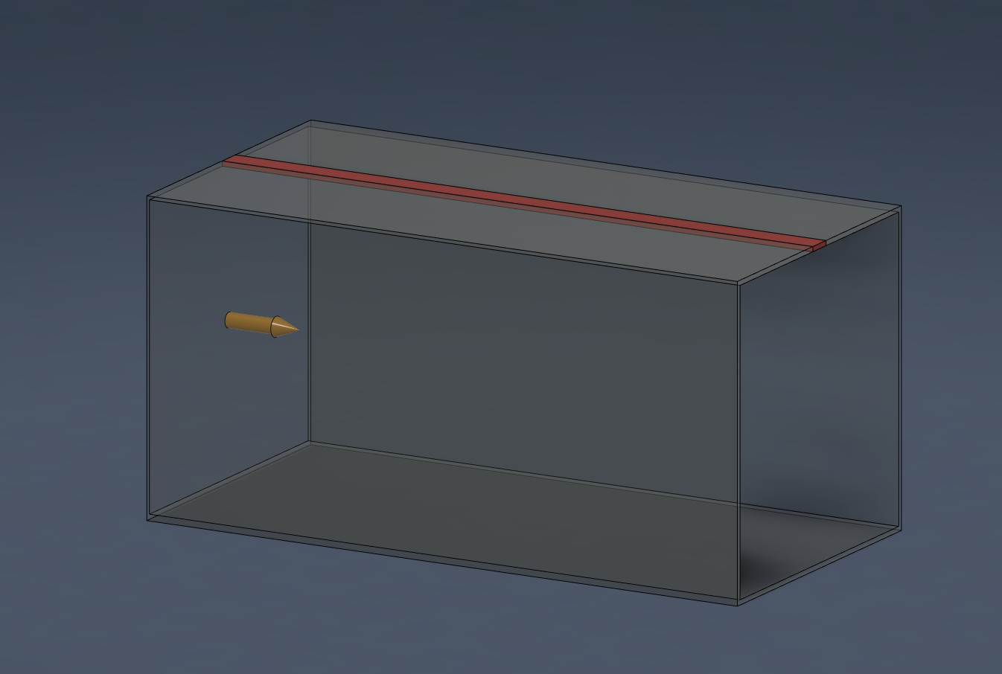

Slide 35
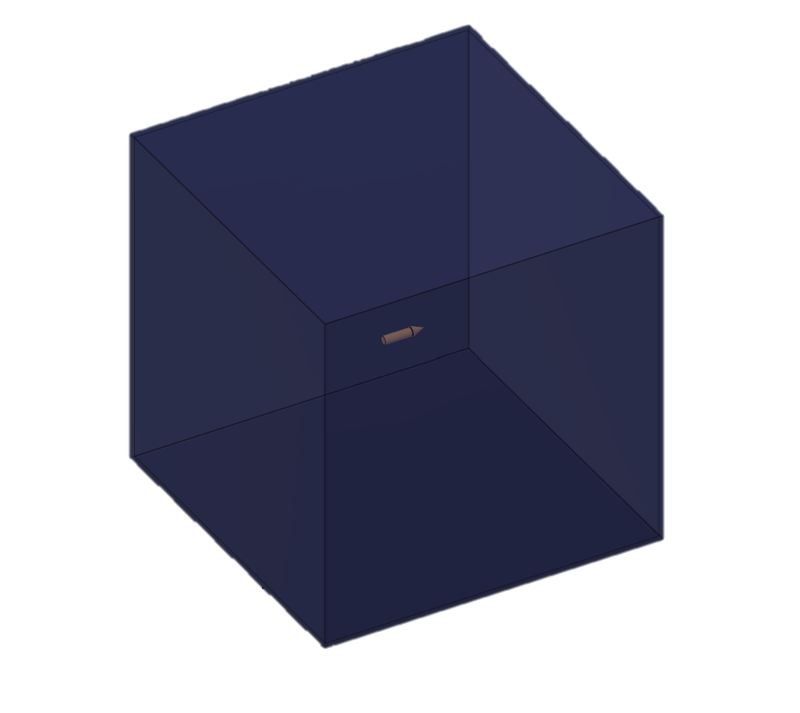
Source
250mm
250mm
250mm

Slide 36
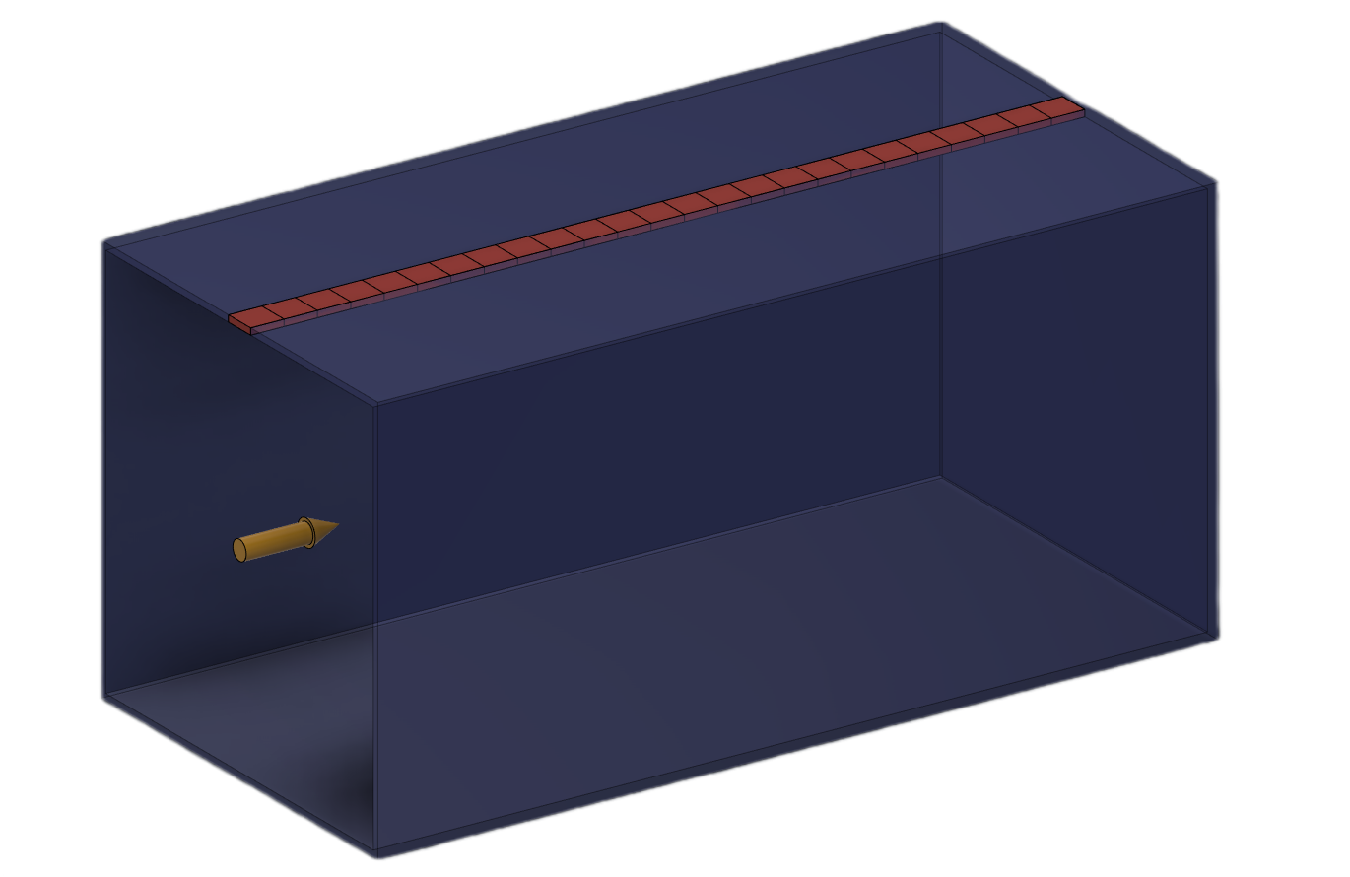

Each square serves as a $1{mm}^{2}$ detector
Variable lenght
30mm
100mm

Slide 37
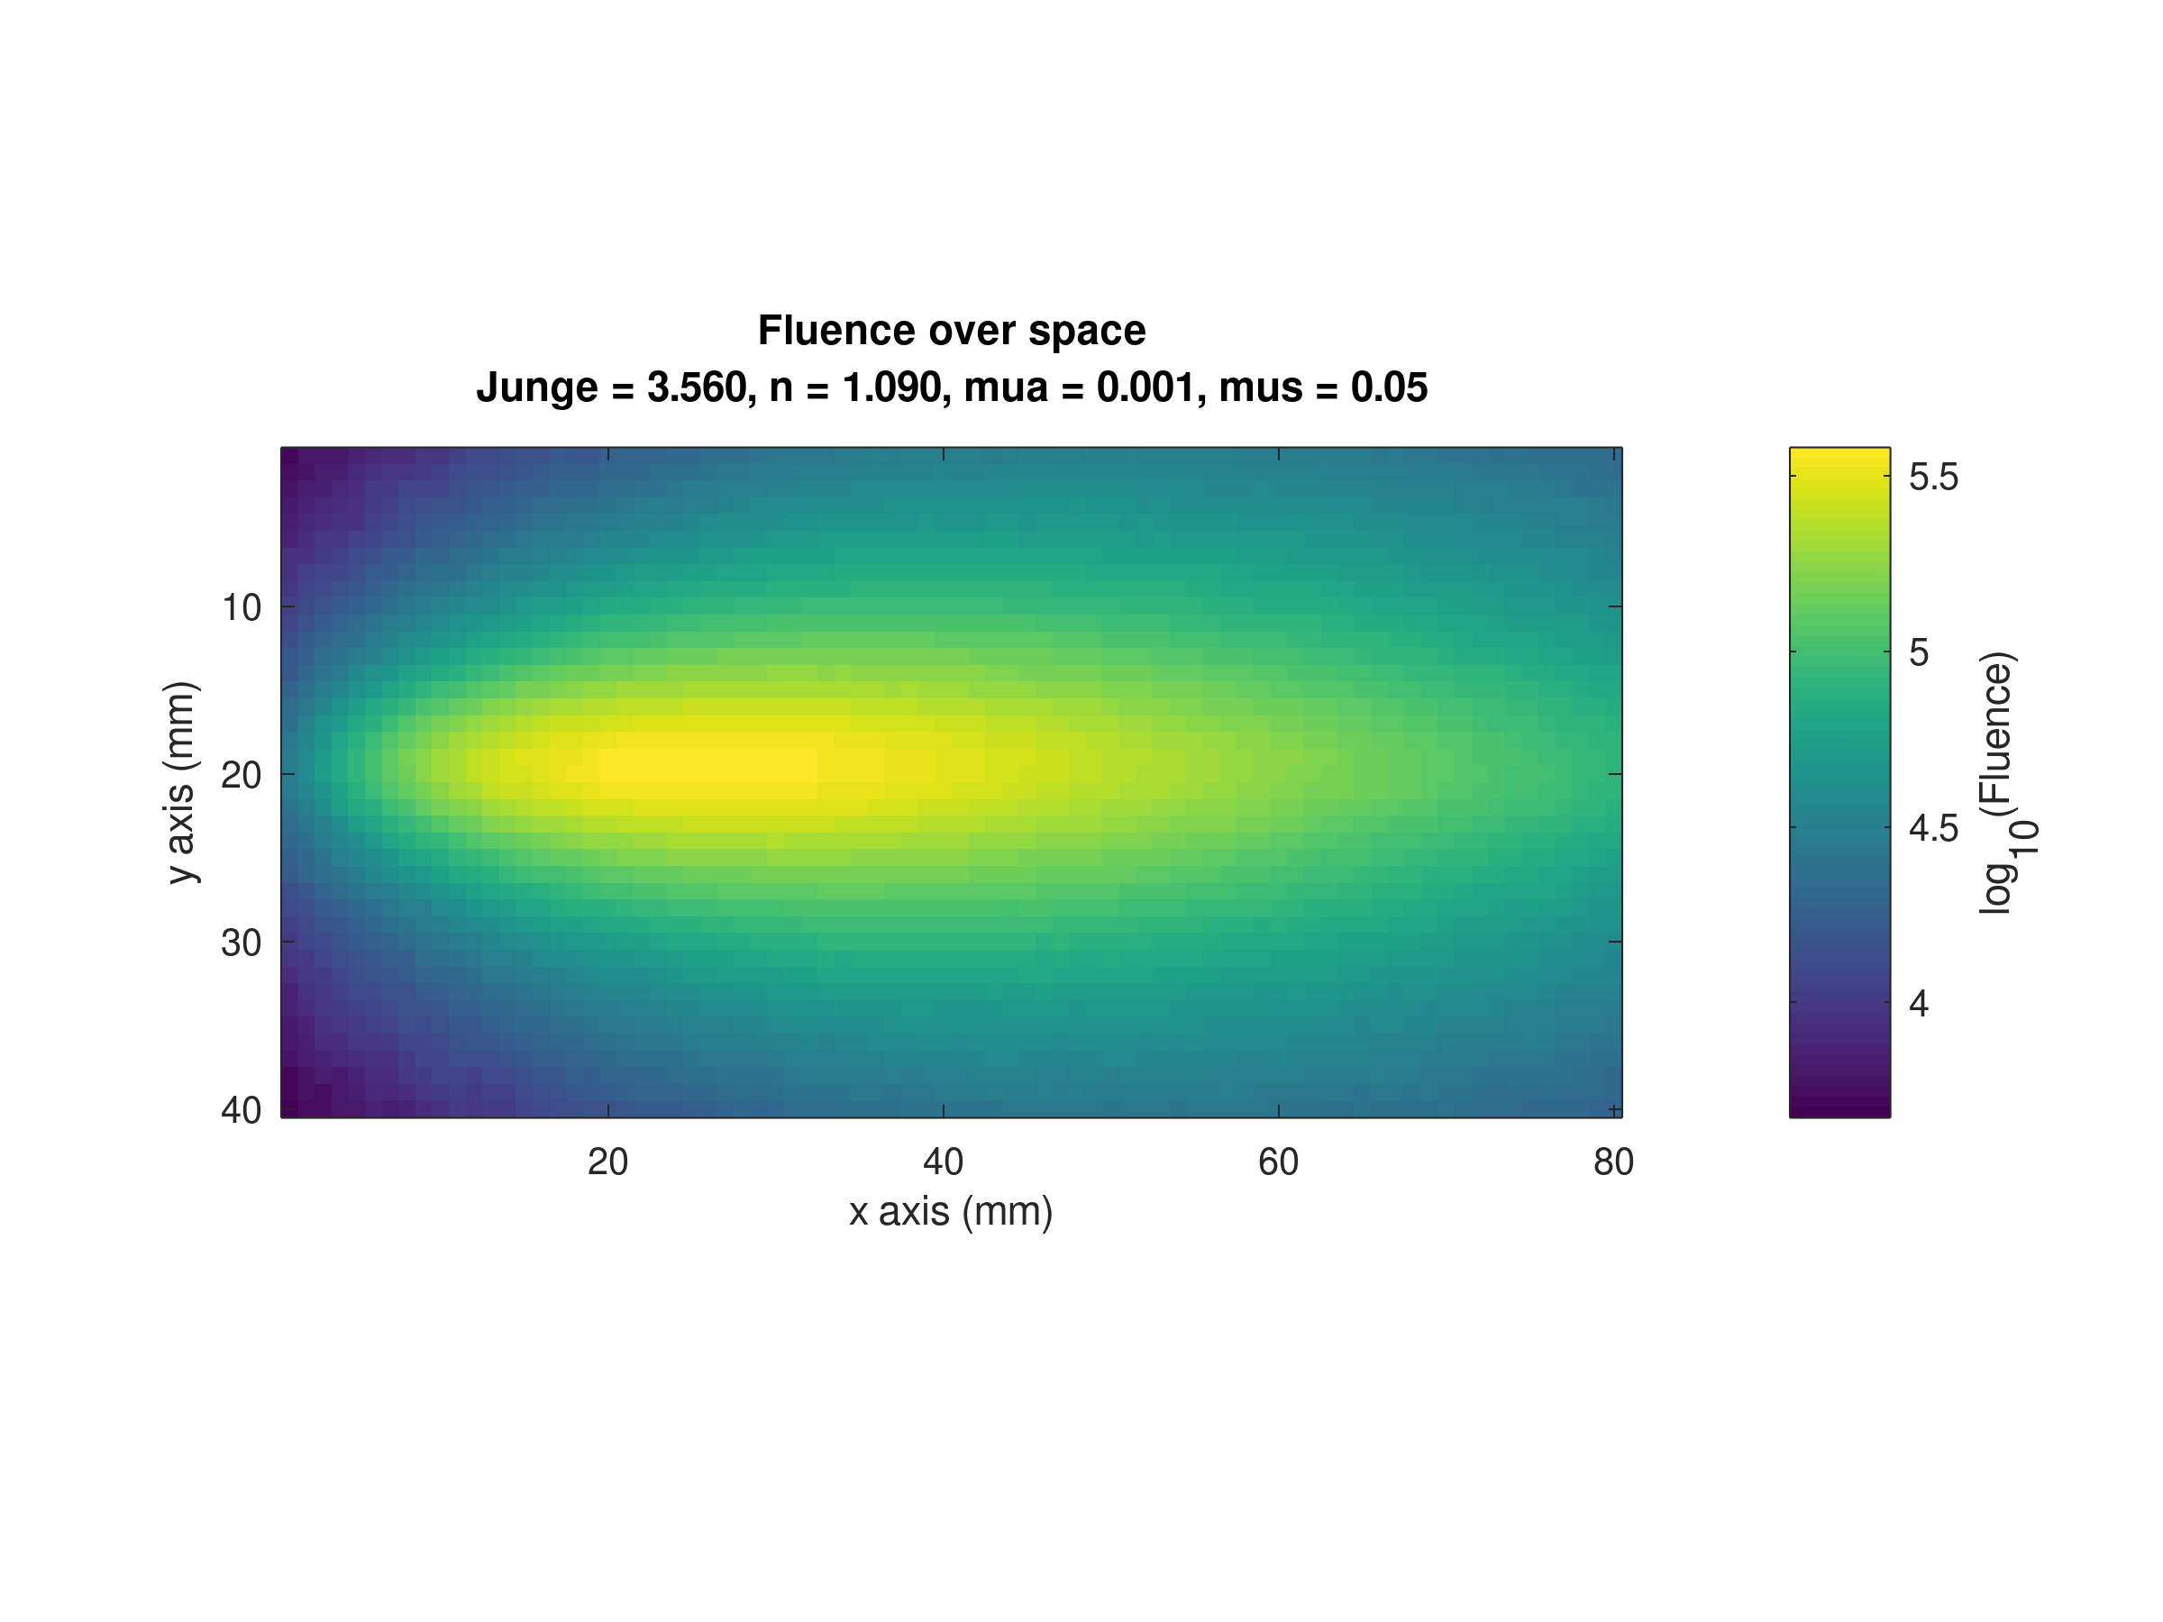

Slide 38
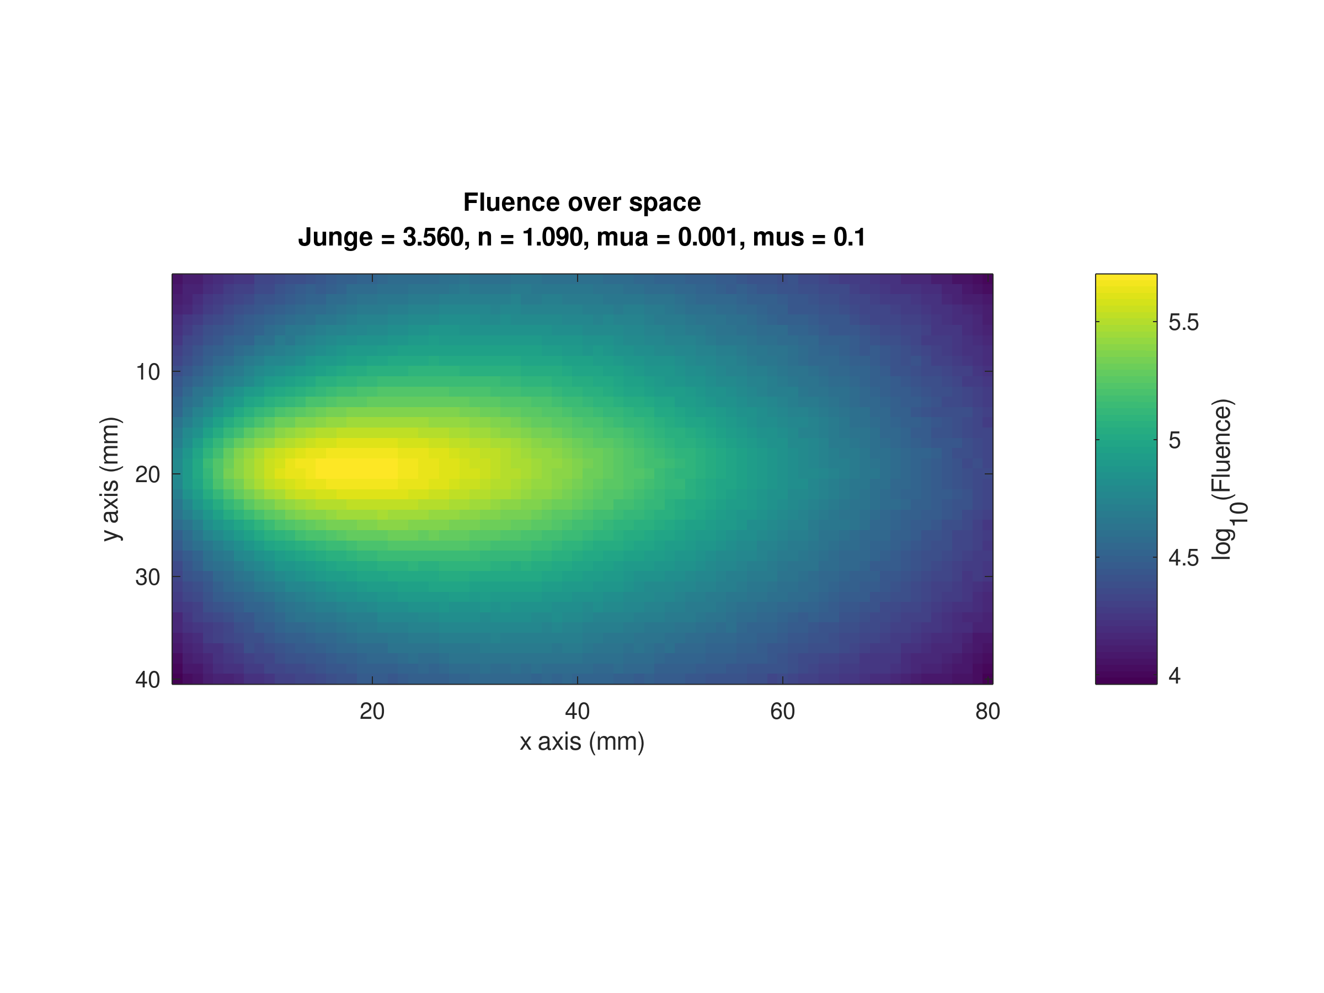

Slide 39
Off the Beam Line Detector
Light Source
Beam Line Detector

Slide 40
Off the Beam Line Detector
15mm
Light Source
Beam Line Detector
75.5mm

Slide 41
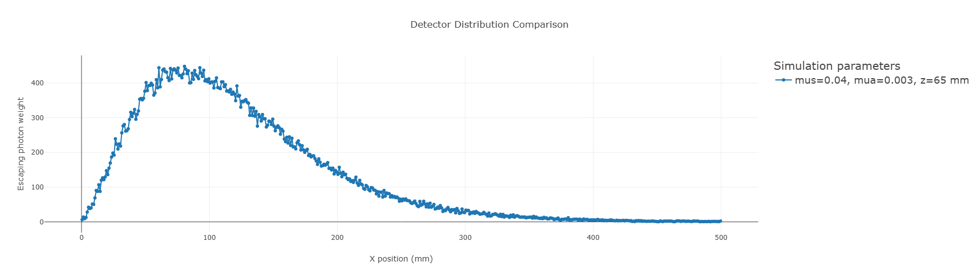
75mm

Slide 42
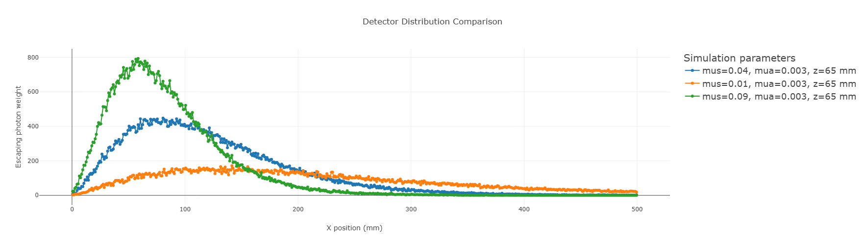
75.5mm

Slide 43



Measurement at distance $d≈5$
Source
Measurement at distance $d≈2.5$

Slide 44
